Slide 1
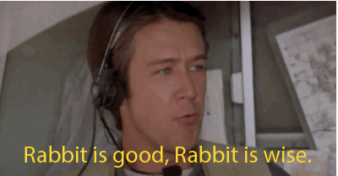
Expectations and Rules for Today
Active Participation Encouraged
Questions are encouraged
Safe Space
Media: get story quotes after the meeting
Judgment free zone
No accusing or blaming
Disagreements are fine, attacks are not
Keep comments to your jurisdiction
Keep comments factual
Make introductions to those you don’t know
One message, multiple voices

Slide 2
Spring Weather Outlook

Slide 3
We’ll talk about...
NWS Centers/Offices
Weather vs Climate
Seasonal Outlook
North Texas Spring Weather Climatology

Slide 4
NWS Offices and Centers
Weather Forecast Offices (WFOs): issue local forecasts, warnings, and advisories. We partner with and serve many local, state, and other federal agencies.
Storm Prediction Center (SPC): monitors the severe weather threat across the country and produces national daily outlooks for severe weather. Issues all Severe Thunderstorm and Tornado Watches and mesoscale updates.
Weather Prediction Center (WPC): monitors the threat for heavy rainfall across the country. Issues single- and multi-day rainfall total guidance and outlooks.
Climate Prediction Center (CPC): one of several National Centers for Environmental Prediction (NCEP). Issues climate outlooks ranging from several days out to several months out.
WPC & CPC are in the Washington, D.C. area. SPC is in Norman, OK.

Slide 5
A Climate Outlook...
…doesn’t attempt to predict the weather.
There is no way reliable way to predict a storm system months (or even weeks) in advance.
…tries to determine what types of weather patterns are more likely to occur during the outlook period.
…considers the course of the entire season.
…does not assess the severe weather threat for the season.

Slide 6
Considerations
Our greatest skill with seasonal outlooks is during the cold season when a more stable ENSO phase has a more predictable impact.
In addition, cold season precipitation patterns are primarily governed by mid-latitude systems, and the resulting rainfall/snowfall is more uniform across the region.
Warm season precipitation can vary considerably from place to place, and seasonal totals can be highly dependent on just a couple of significant events, making outlooks on seasonal time scales much more challenging.

Slide 7
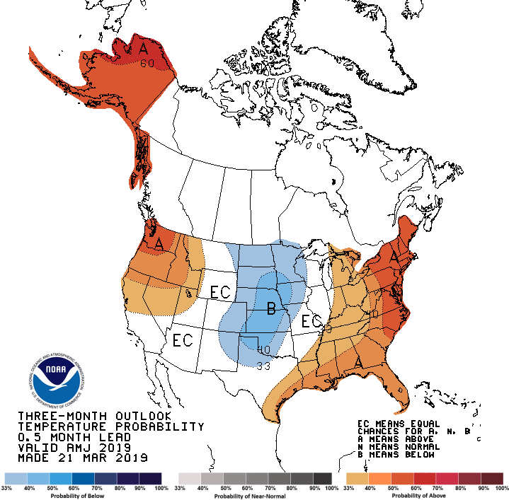
Latest 3 Month Outlook - Temperature

Slide 8
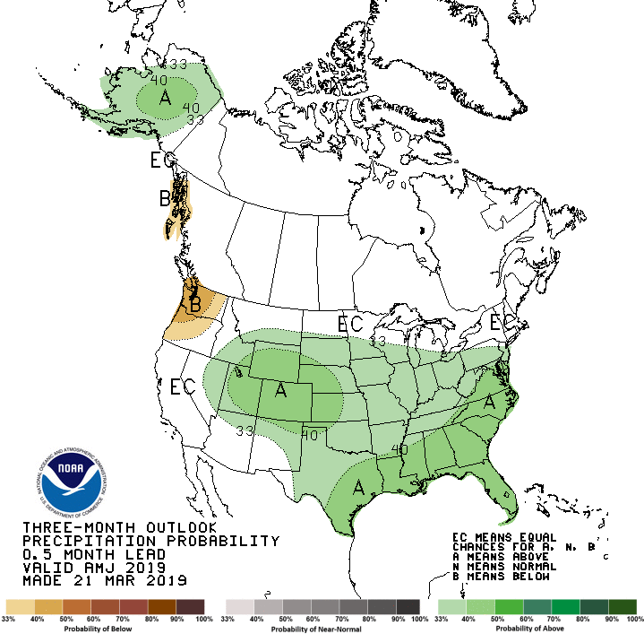
Latest 3 Month Outlook - Precipitation
Some guidance suggests this Spring could be quite wet
Above normal precipitation also has some ties to an active severe weather season

Slide 9
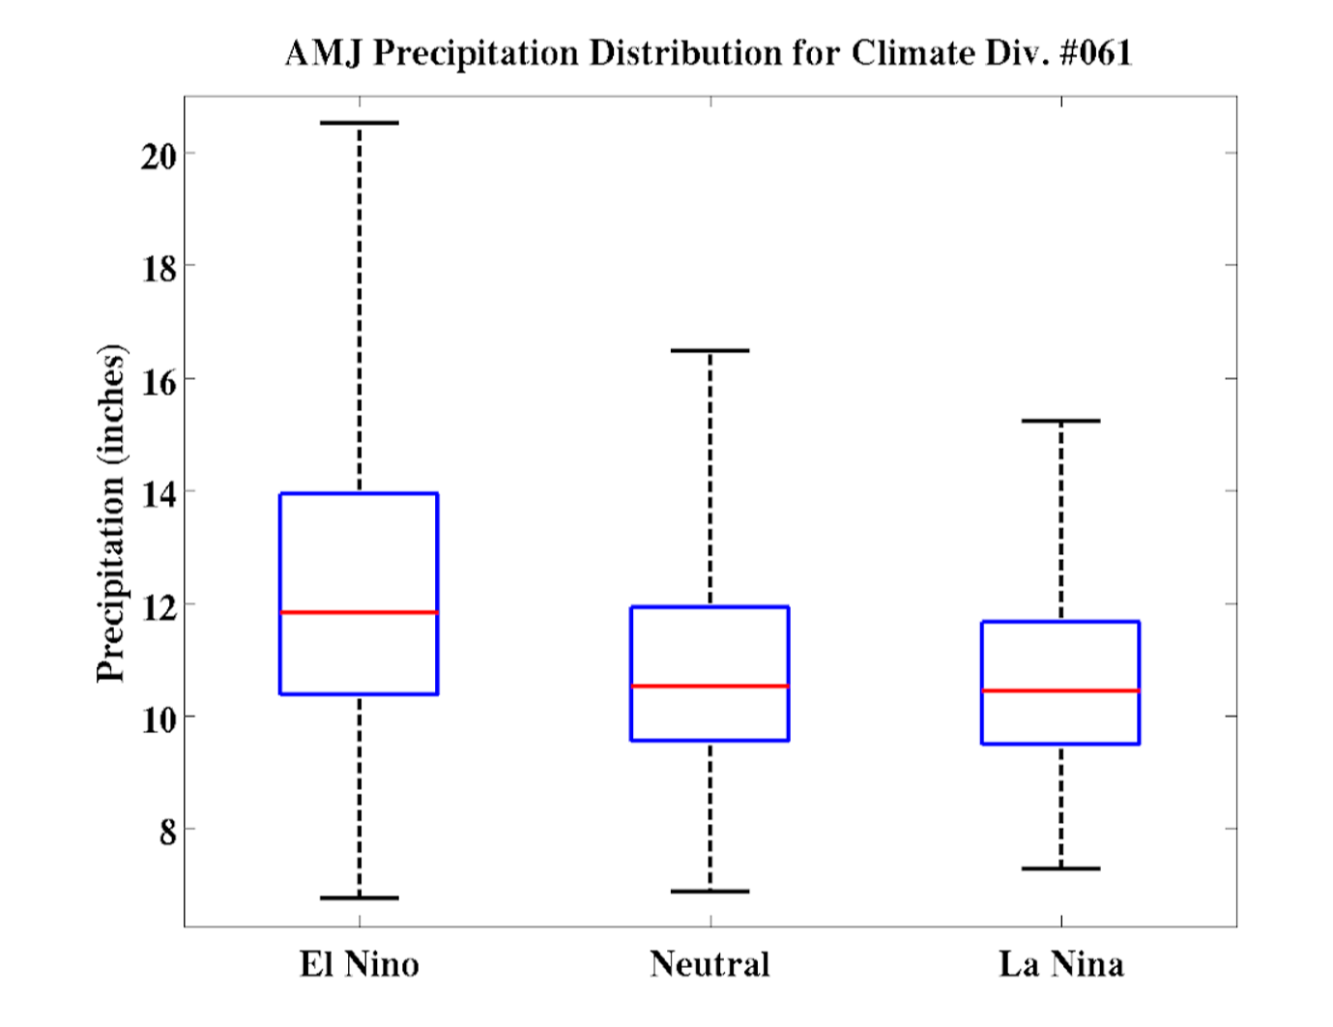
April-May-June Precipitation Totals
(by ENSO Phase)
ENSO has a stronger impact in the winter, but we are expecting at least a weak El Nino to continue through the spring months
Climatologically have wetter spring seasons in El Nino patterns

Slide 10
North Texas Spring Weather Climatology
The spring months are typically some of our wettest months of the year
May = Wettest
June = 3rd wettest
Our past 3 of 4 El Nino winters have been followed by some of the wettest spring months
But El Nino barely developed this past winter
Mid March though early June is our peak severe weather season
We ALWAYS have severe weather during this months

Slide 11
Takeaways
Signals indicate a wet Spring is possible
May also be linked to more active severe weather….but not a guarantee
Threat for flooding may be higher due to above normal precipitation!
Mid March through early June is peak severe weather season
Must ALWAYS be prepared
Make your preparations NOW!

Slide 12
Questions/Comments/Concerns

Slide 13
NWS Products Review
National Weather Service
Fort Worth, Texas

Slide 14
We’ll Talk About…
Routine Products
Severe Weather Products issued before, during, & after the event
Flood Products
River Products

Slide 15
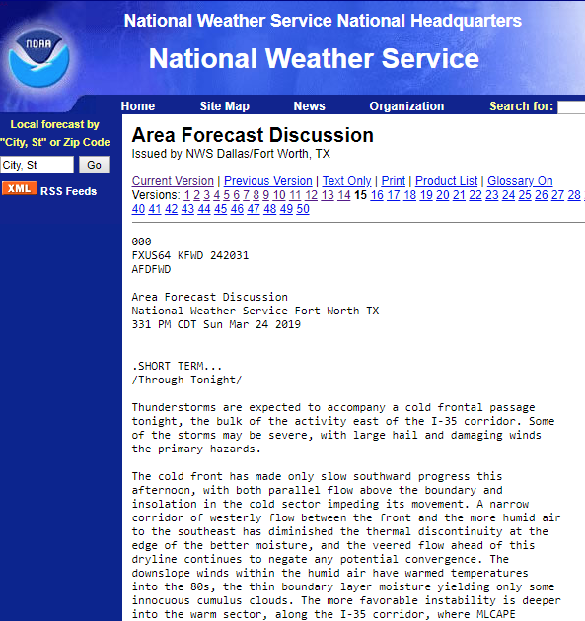
Area Forecast Discussion
Routine product issued during the early morning and afternoon hours
Scientific discussion of the weather pattern during the next 7 days
Updates issued when needed

Slide 16
Hazardous Weather Outlook
Provides a brief discussion on hazards (strong to severe thunderstorms, hail, damaging winds, tornadoes, winter weather, etc.)
Also includes Spotter Information Statement (required)
Notes:
Point out that we are required to have the Spotter Information Statement. Is there a better way we can word this for our partners? Will our office be reevaluating how and if we use this?

Slide 17
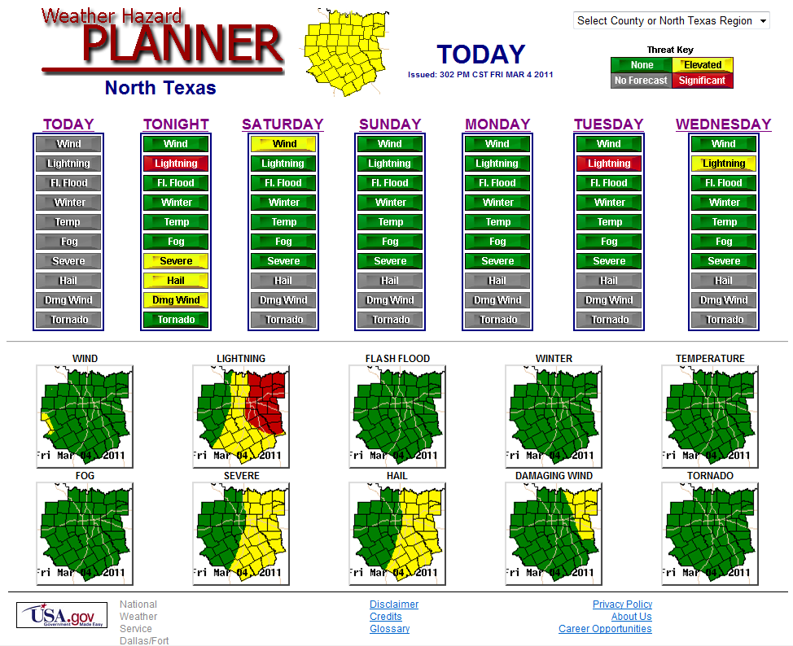
Hazard Planner
A visual breakdown of threats over several days across the region.
Green = None
Yellow = Elevated
Red = Significant
Notes:
Make sure to point out you can customize it by county. Larger size to see the threats?

Slide 18
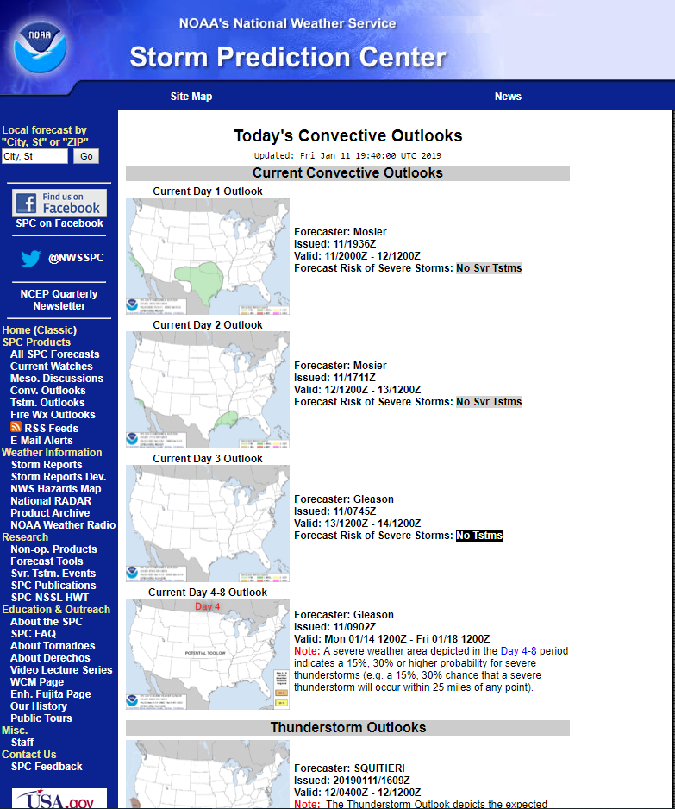
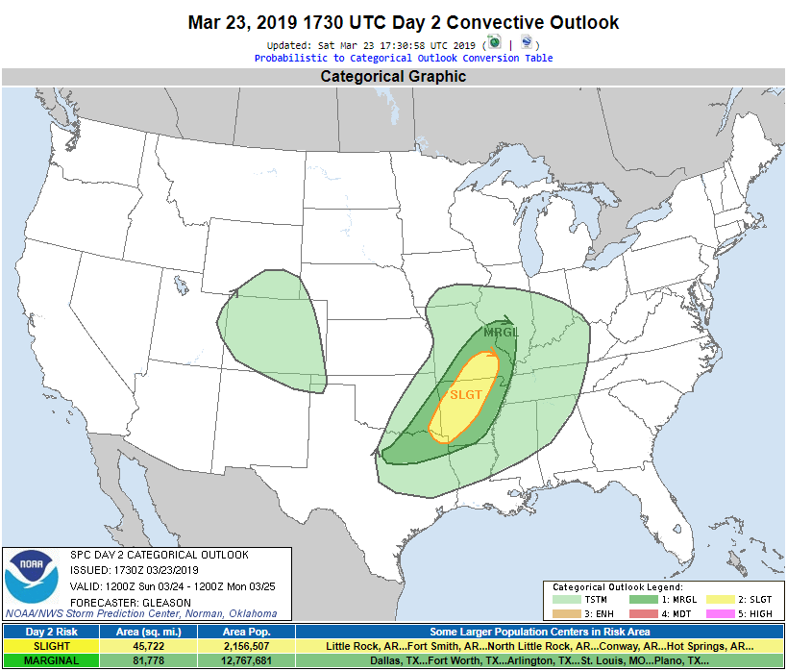
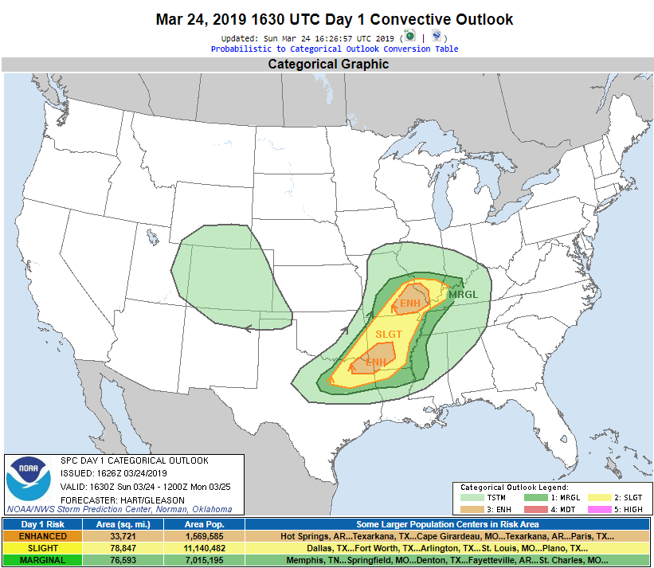
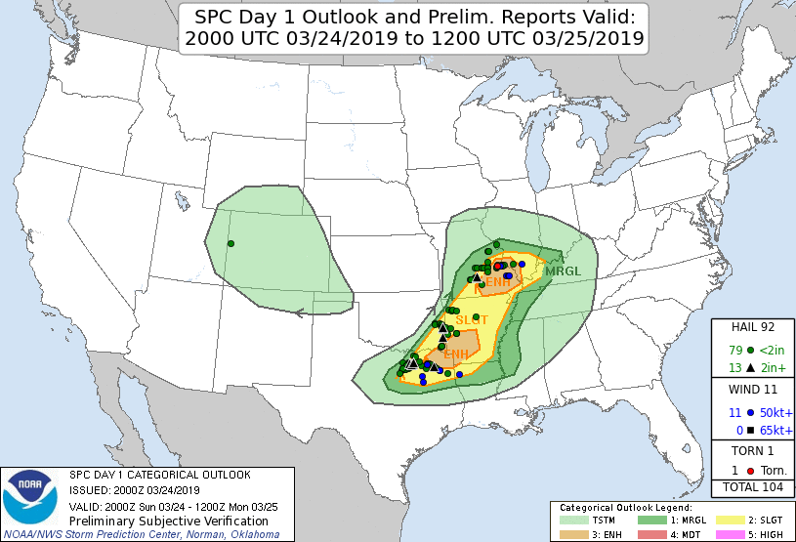
SPC Convective Outlooks
National forecast outlook on the risk of severe thunderstorms and possible hazards.
Risk tells you about coverage, not intensity.
The majority of our severe weather happens in a Slight/Enhanced risk!
Notes:
Mention majority of our severe weather happens in MRGL and SLGT? or something about don’t brush off that we aren’t in a higher category. Check our local products.

Slide 19
Local Study on SPC Convective Outlooks
The majority of our severe weather happens in a Slight or Enhanced risk
Study based on 12z SPC Outlooks for North Texas from Oct ’14 – Oct ’16

Slide 20
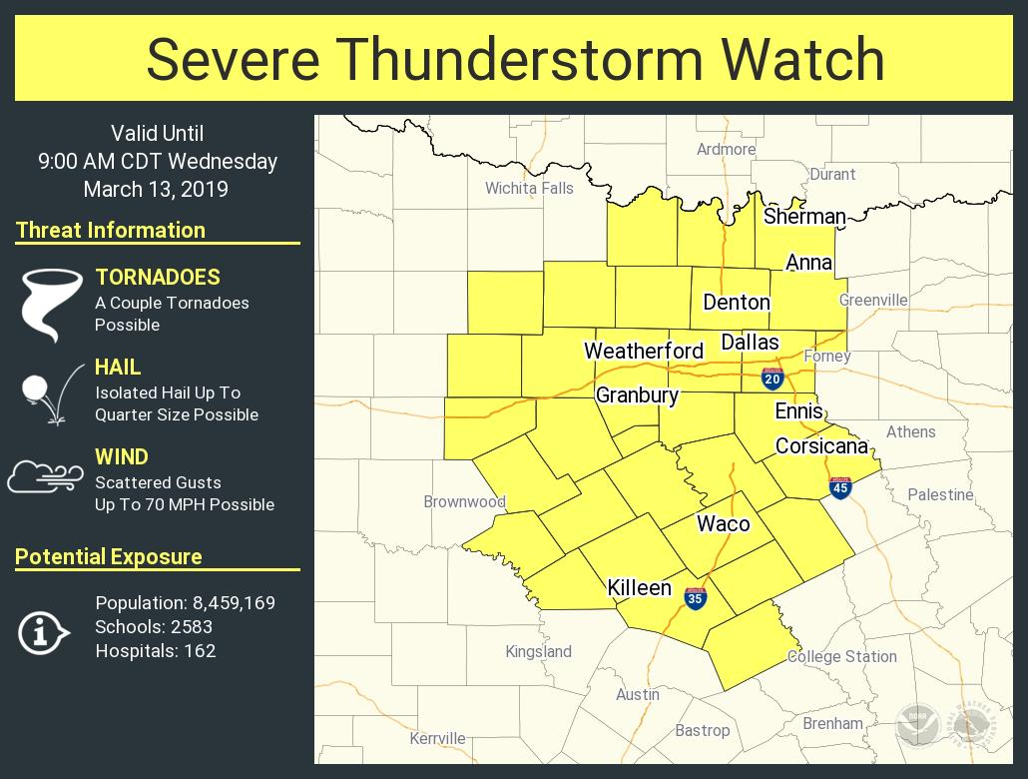
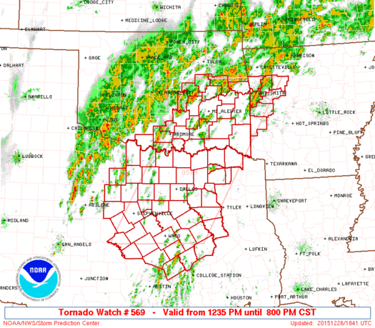
Severe Thunderstorm/Tornado Watch
Cover large areas that may be impacted by weather in the next several hours
Typically in effect for about 6 hours
Storms may already be occurring, or they may not have developed yet
Conditions are conductive to support severe/tornadic storms
Local offices clear counties in the watch as needed/threat ends…but not immediately
Notes:
Best slide ever!! Lol!

Slide 21
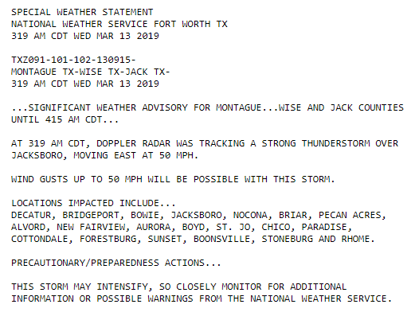
Special Weather Statement
Issued for strong storms that do not meet severe criteria
Gusty winds below 60 mph
Hail smaller than quarter size
Will pop up in NWSChat
Don’t discount these statements!
Notes:
Don’t discount...will mention if we think the storm could intensify

Slide 22
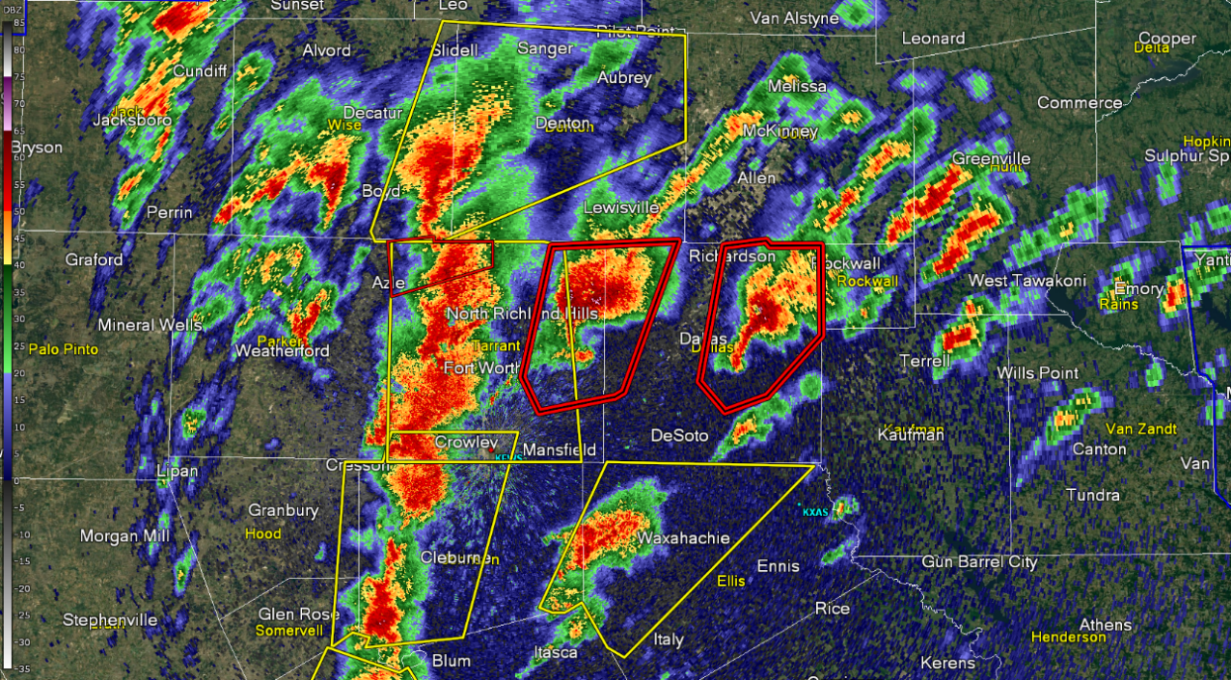
Severe Thunderstorm/Tornado Warnings
Cover a smaller, localized area
Typically in effect for 30-60 mins
Tornado or severe storm threat has been detected on radar and/or reported
Severe Thunderstorm Warning: 1” hail and/or winds near 60 mph
Tornado Warning: Tornado
Local offices can expire, cancel or reissue warnings as needed
Notes:
Another awesome slide!!!

Slide 23
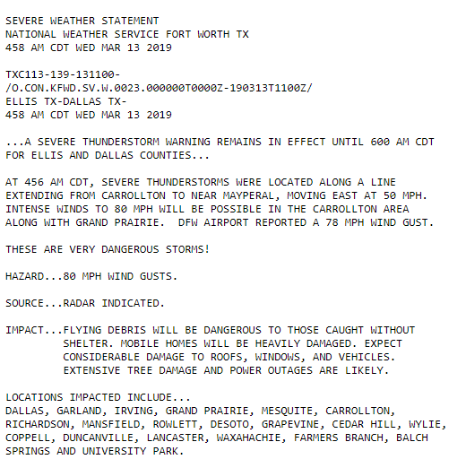
Severe Weather Statement
An update to a warning
May include recent storm reports our office has received
Hazards may change based on storm reports!
Original hazard: 65 mph wind gusts
Notes:
Great example and explanation!

Slide 24
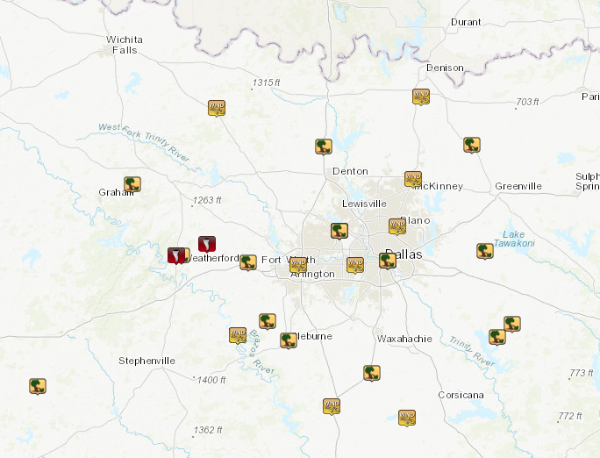
Local Storm Reports
May be done during and after the event as reports stream in through:
NWSChat
Social Media
Phone Calls
Amateur Radio
mPing and more
Click on any storm report link in NWSChat and adjust the time to see reports across the region
Notes:
mPing or “and more”

Slide 25
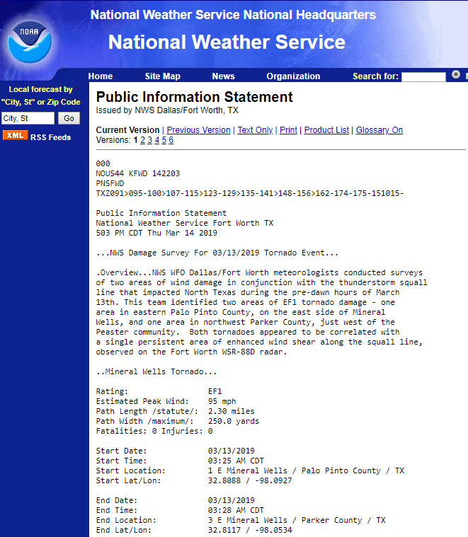
Public Information Statements
An event summary prepared and updated as teams conclude damage surveys
Can also be a summary
Peak wind gusts
Precipitation amounts
Hail size, etc.
Notes:
Storm report summary

Slide 26
Everbridge Briefings
We send Everbridge notifications in advance of warnings and/or when we are concerned about tornadic potential or immediate threat (more on that coming up)
We may send an Everbridge message as a courtesy “head’s up” for storm/weather related events that aren’t severe or tornadic storms
Not a guarantee; depends on staff situational awareness and workload
Check NWSChat for similar messages
Examples:
Large outflow boundary moving across the region on July 3rd or 4th
Strong storm developing near a known, large festival or event
Sub-severe storm producing large amounts of large hail
Use the same lists for Severe Storm Notification/Spotter Activation and Briefings
Don’t need to request to be added to a separate/new list
Notes:
Storm report summary

Slide 27
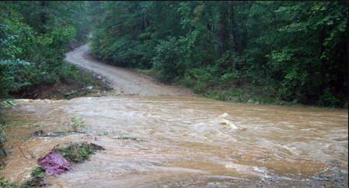
Understanding the Flood Products
West Gulf River Forecast Center
NWSWGRFC
@NWSWGRFC
Urban / Small Stream Advisory WHAT IS IT? Flooding of small streams, streets and low-lying areas. WHAT TO DO? Stay away from areas that are prone to flooding and stay clear of rapidly moving water | Flood Watch WHAT IS IT? Flooding is possible – typically within 6 to 48 hours before rain is expected to reach the area. WHAT TO DO? Stay tuned to local river forecasts; prepare for areas near rivers to spread towards nearby roads and buildings | Flash Flood Watch WHAT IS IT? Flash flooding is possible –typically 6 to 48 hours before rain is expected to reach the area. WHAT TO DO? Have a way to receive local warnings, expect hazardous travel conditions and have alternate routes available | Flood Warning WHAT IS IT? Flooding impacts are occurring or imminent. WHAT TO DO? Stay alert for inundated roadways and follow all local signage! Additional impacts include homes and structures could become flooded and need to be evacuated | Flash Flood Warning WHAT IS IT? Flash flooding impacts are occurring or imminent. WHAT TO DO? Conditions will rapidly become hazardous! Do not cross flooded roadways or approach inundated areas as water may still be rising | Flash Flood Emergency WHAT IS IT? Flash flood situation that presents a clear threat to human life due to extremely dangerous flooding conditions WHAT TO DO? Immediately reach higher ground by any means possible
How is a flash flood different from a standard flood?
Flash floods are characterized by rapid rise of water on the order of a few minutes to 6 hours that can occur anywhere.
A flood watch or warning pertains to larger streams and rivers that take much longer to respond (3 hours to weeks) but move much larger amounts of water through sensitive areas. Flood Warnings can last 6 to 12 hours to weeks for a single location.
Flooding Can Happen Anywhere. Are you “Flood Prepared”?
Be Flood Aware. Turn Around. Don’t Drown!

Slide 28
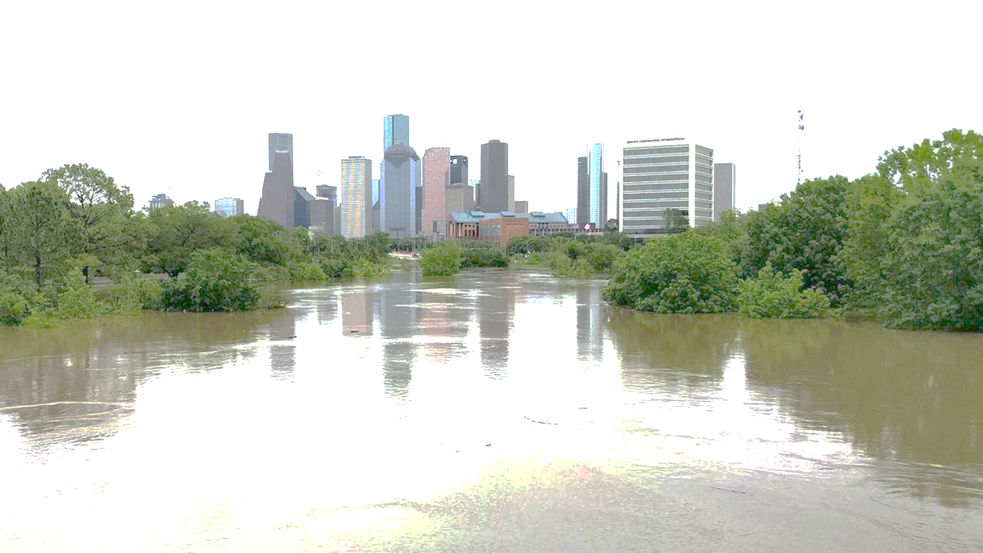
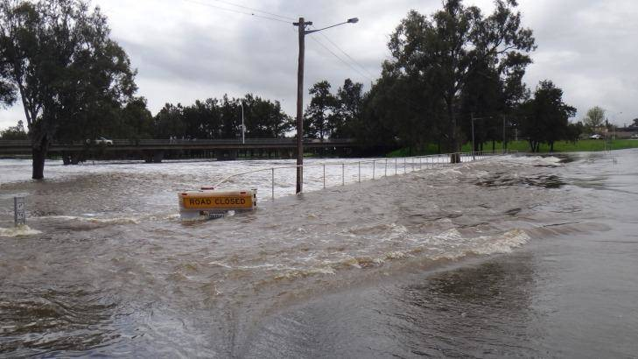
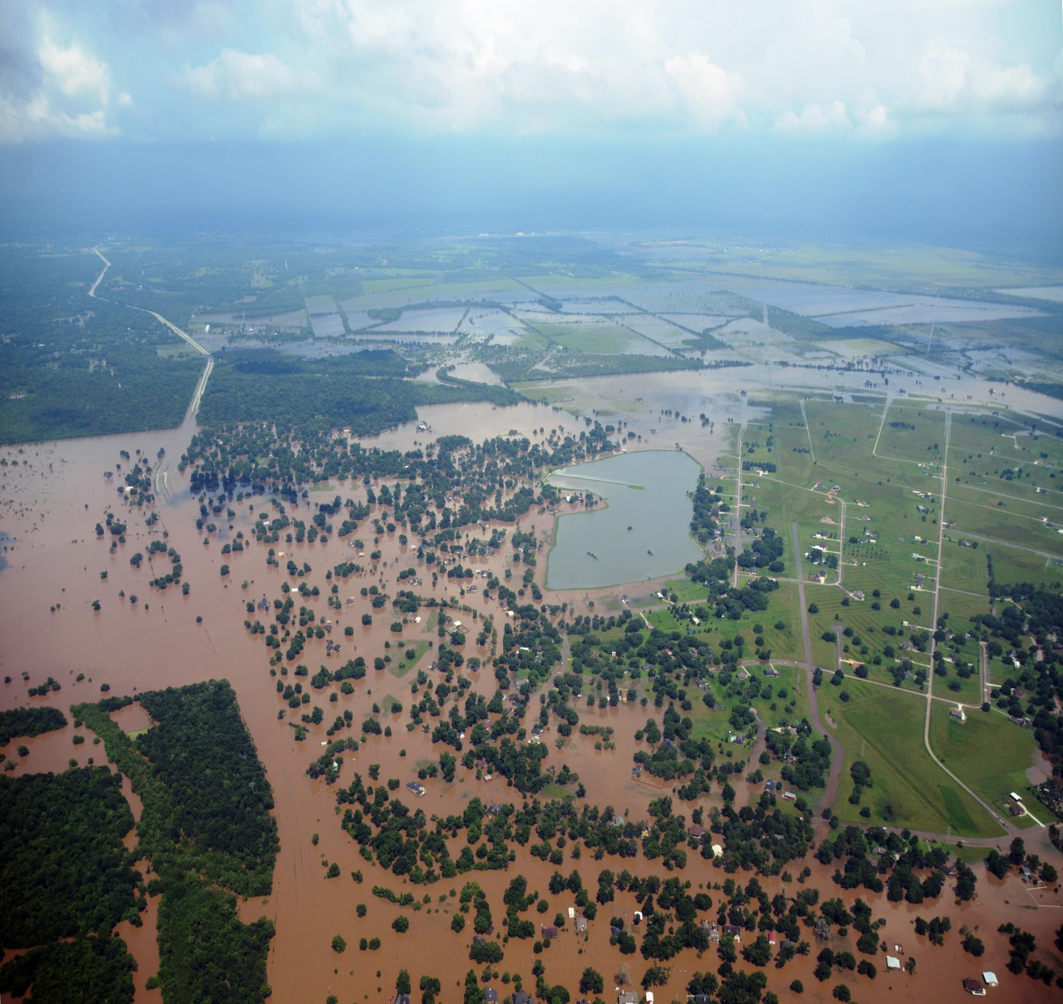
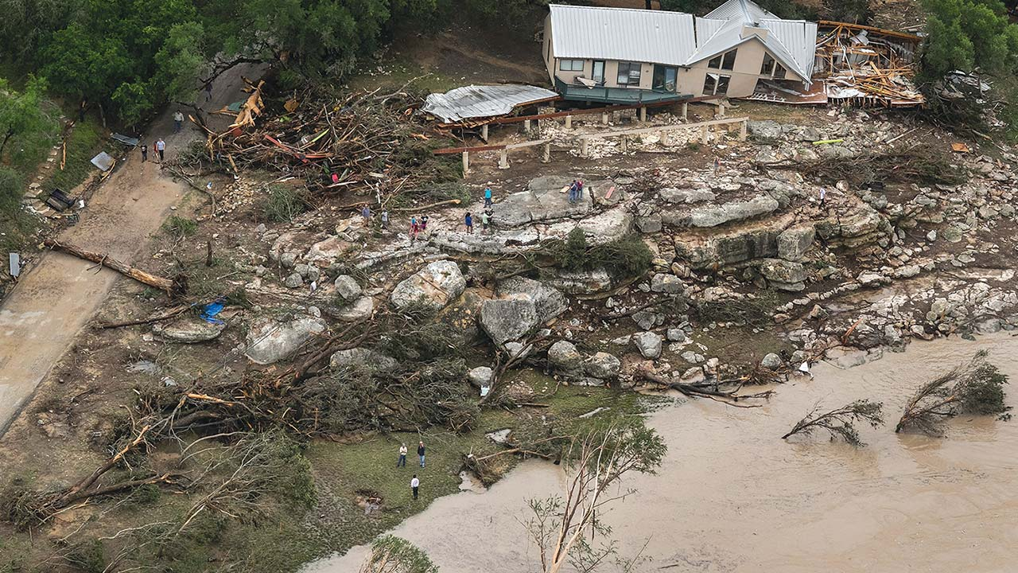
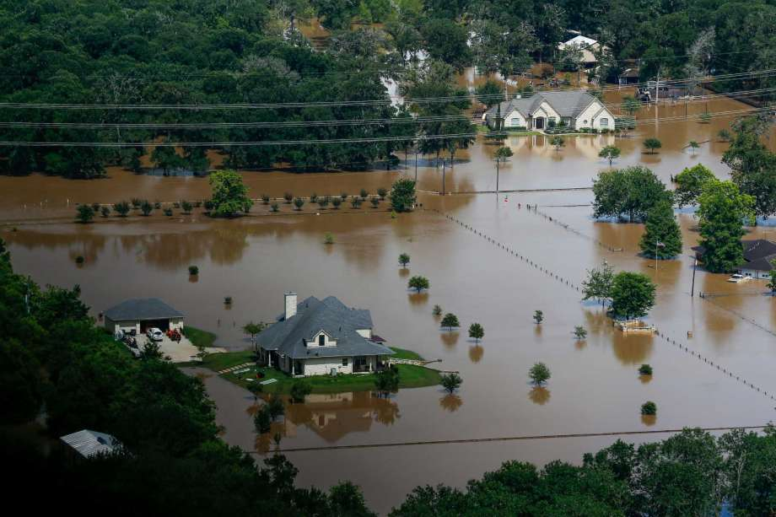
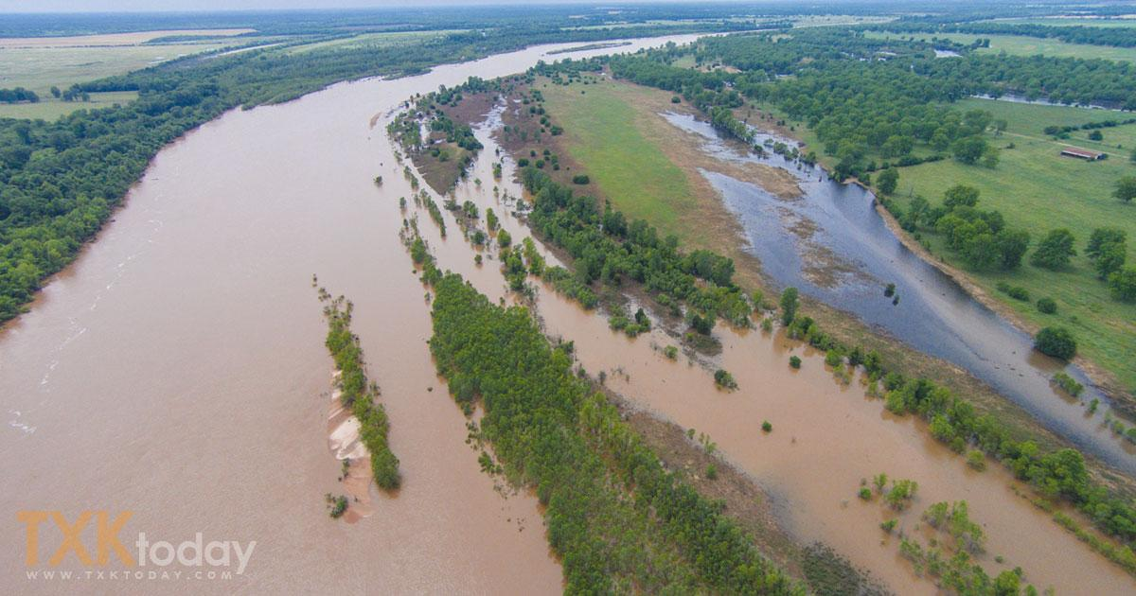
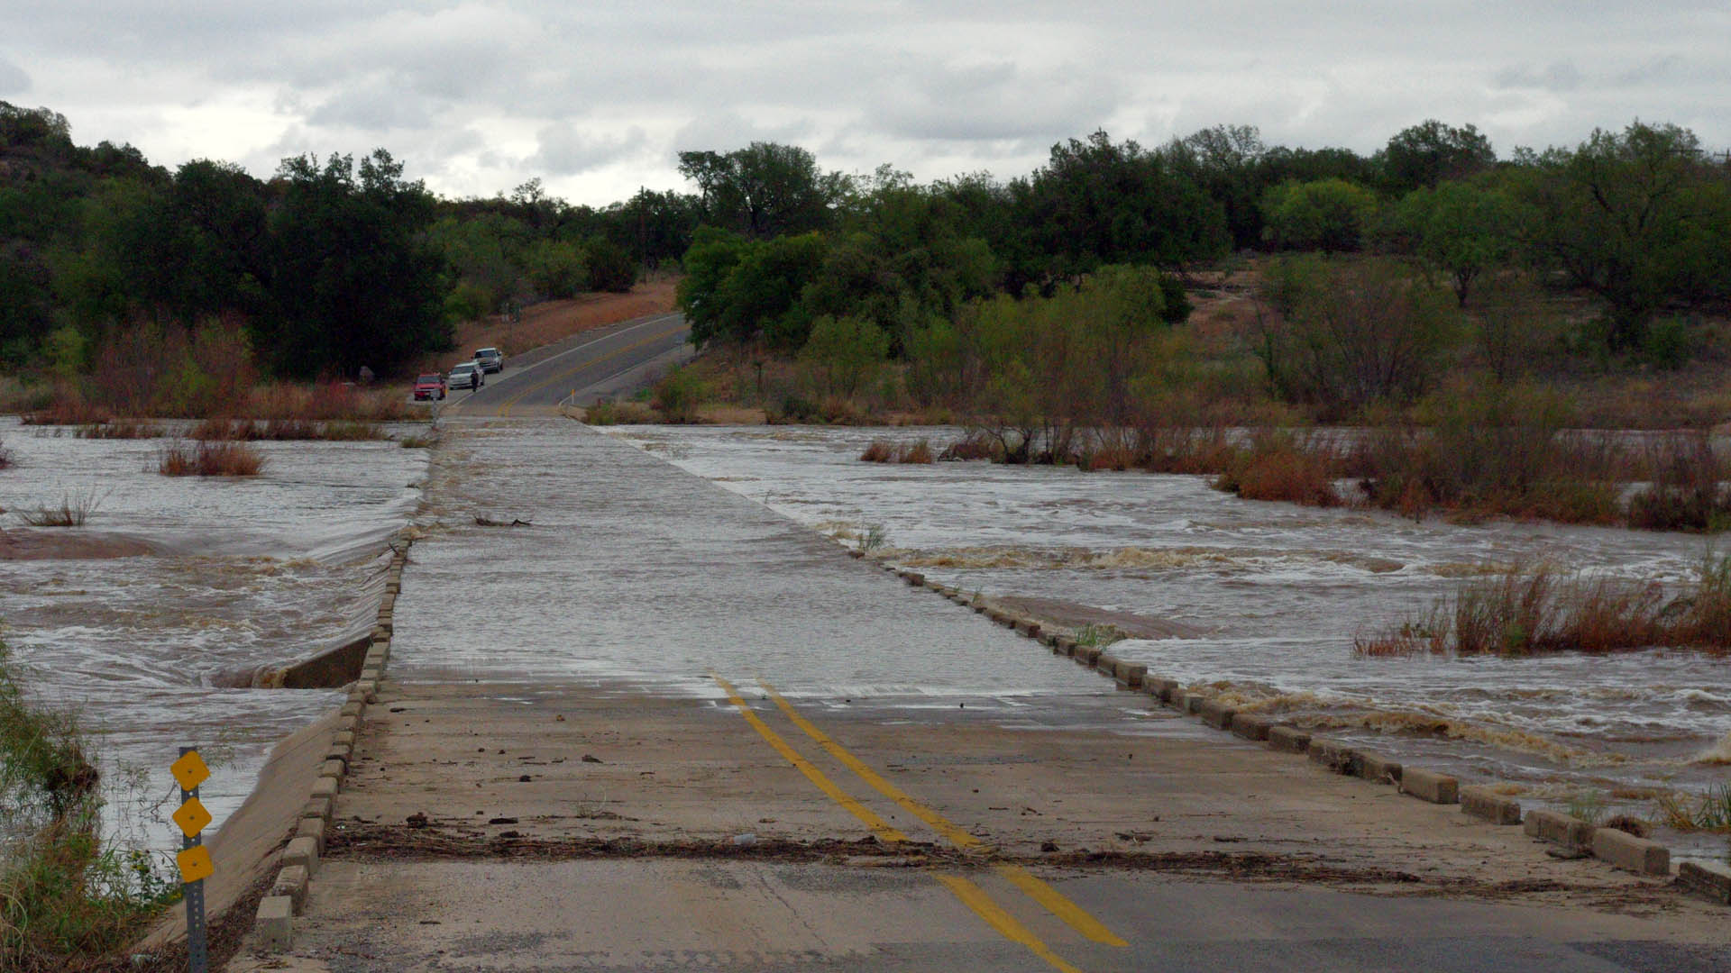
Understanding Criteria Levels
West Gulf River Forecast Center
BELOW CRITERIA
Impact: Water is within the banks of the river with no impacts to the surrounding area. Flow speeds may still be high during rainfall or releases which could impact recreational activities
ACTION
Impact: Water is over the banks and into the flood plain, but not a threat to structures or roadways. Some action may be required such as moving farm equipment or increasing awareness
MINOR
Impact: Typically water is impacting areas inside of flood plain which can vary by location. Some low water crossings covered by water, agricultural flooding, water approaching public areas (parks, sidewalks etc.). Areas frequently flooded can expect to be impacted
MODERATE
Impact: Water now reaching areas only impacted by significant rain events. Structures can be inundated, several roads covered with water, water may cut off certain areas, widespread agricultural flooding.
MAJOR
Impact: Water is near the highest its ever been representing rare flooding and significant widespread impacts. Most roads will be covered by water in the area cutting off if not completely flooding subdivisions, rivers can be several miles wide in areas. Homes and structures underwater, bridges inundated and in danger of being hit by debris. Impacts may be greater than ever experienced.
RECORD FLOODING: Impacts that have never been experienced before and are therefore unknown

Slide 29
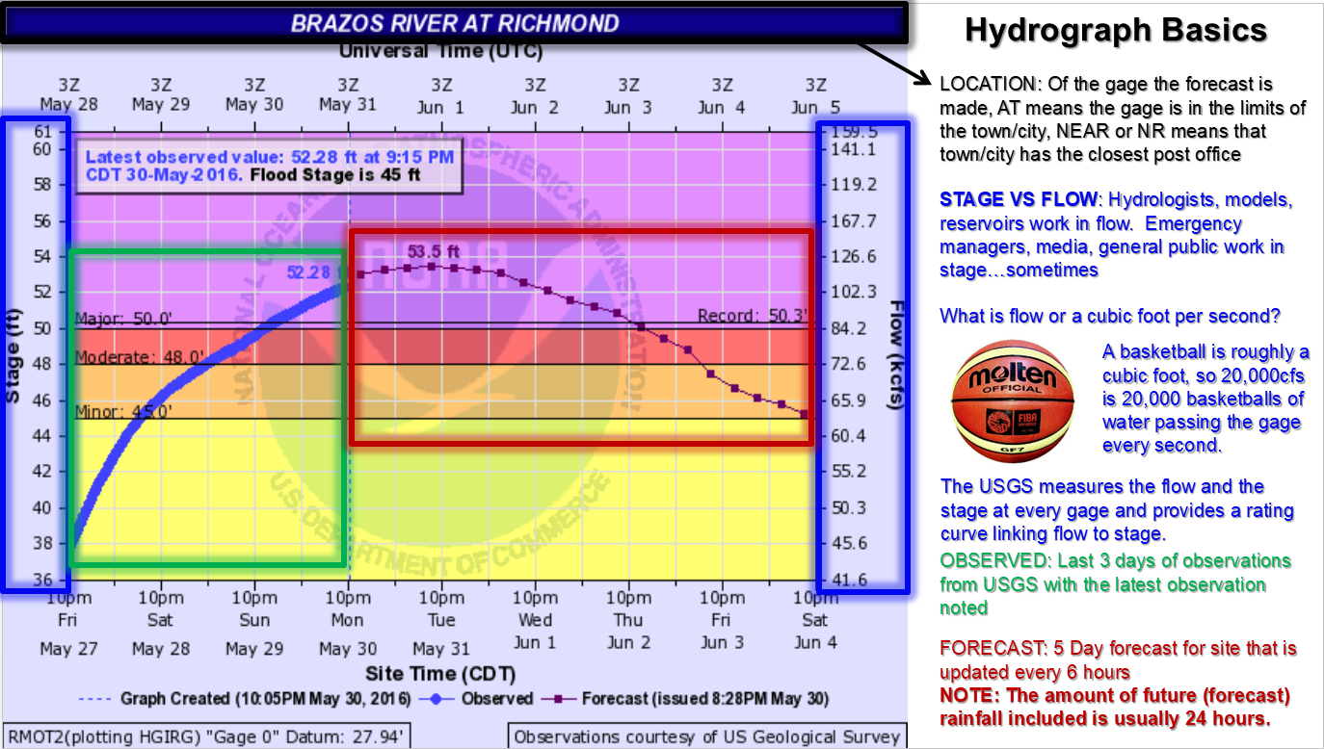
Notes:
Convective parameters?

Slide 30
Questions / Discussion

Slide 31
NWS UPDATE Emails

Slide 32
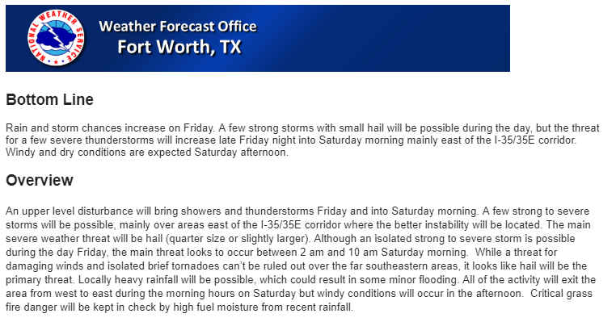
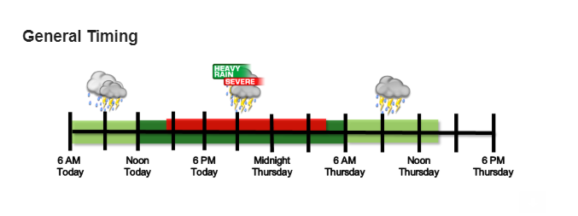
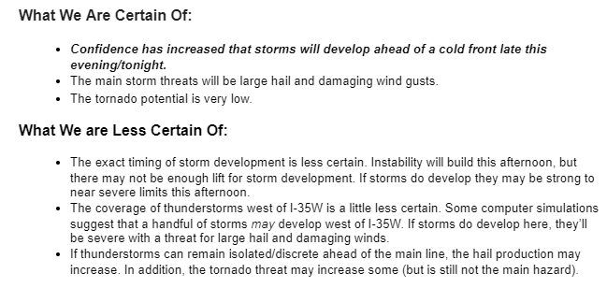
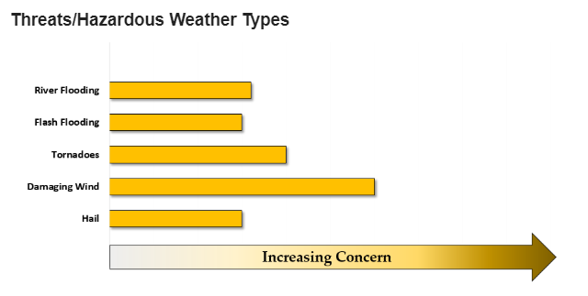
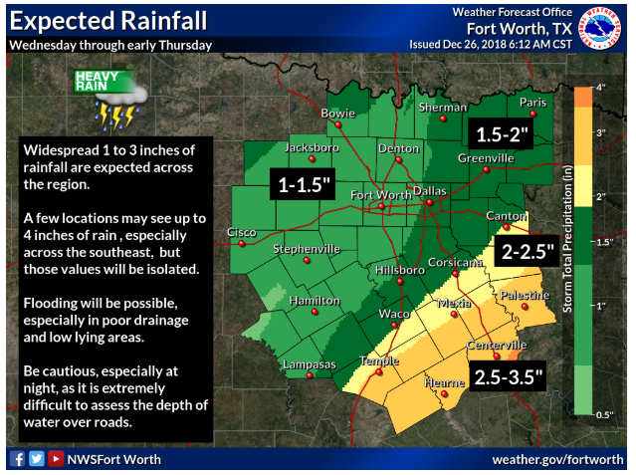
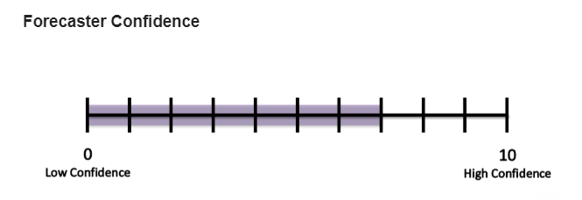
How do we decide when to send these?

Slide 33
Communication
“The single biggest problem in communication is the illusion that it has taken place.”
-George Bernard Shaw
Are we (the weather people) communicating in a way that everyone (non-weather people) understands?
A lack of effective communication could cause a perfect forecast to go to waste!

Slide 34
Often subjective. Are the speaker and listener on the same page?
Communicating uncertainty with words is extremely difficult…
Does a meteorologist use words to convey uncertainty the same way that an emergency manager does?

Slide 35
Meteorologists have a hard time just saying what you want to know: “Is it going to be bad for me or not?”
“Bad” is usually rare and thus difficult to predict.
Sometimes meteorologists speak in code (shop talk) to say “bad”
We May Say… | What It Means…
Long-Track Tornadoes | The really bad tornadoes we all fear.
Brief or Weak Tornadoes | Tornadoes may happen, but we don’t expect the real bad ones.
Very Large Hail / Giant Hail | Baseball size or greater.
Destructive Winds | Wind damage potential greater than “damaging winds.”
[Literally anything…] | [Sometimes even we have no idea what another meteorologist is trying to say…]

Slide 36
Using pictures can help bridge the communication divide!

Slide 37
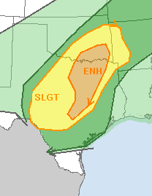
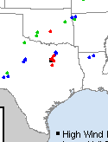
The Threat Bars
Severity and frequency of the hazards are often at odds with each other
Is an event with quarter size hail over 50% of the area the same as an event where only 10% of the area may get softball size hail?
2 big 15 mile long tornadoes produce more potential damage than dozens of small brief tornadoes.
“Increasing Concern”
Incorporates Hazard Type:
Areal Coverage
Severity
Rarity
Societal Impact/Exposure
These risk categories from SPC are ONLY for coverage of all types of severe weather!

Slide 38
The Confidence Bars
“The forecast in the email is what’s going to happen.”
“Prepare for the unknown and undiscussed. Please check back for forecast updates as we try to figure this system out.”

Slide 39
The Known Knowns and the Known Unknowns
“Take it to the bank.”
Good for tweets or short summaries of what is expected.
Alternate plans to have in your back pocket ready to go.
Depending on how weather savvy you are, you may be able to see how the forecast is trending. If not, just ask!

Slide 40
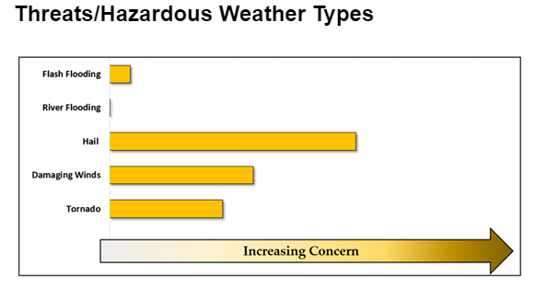
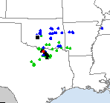
Let’s look at some real examples
47 reports of hail; 8 Very large
2 reports of 60 mph wind
1 tornado

Slide 41
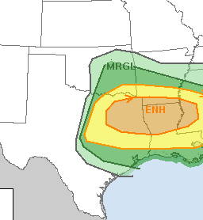
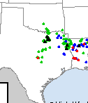
33 Hail Reports (some baseball)
0 Wind
1 Tornado

Slide 42
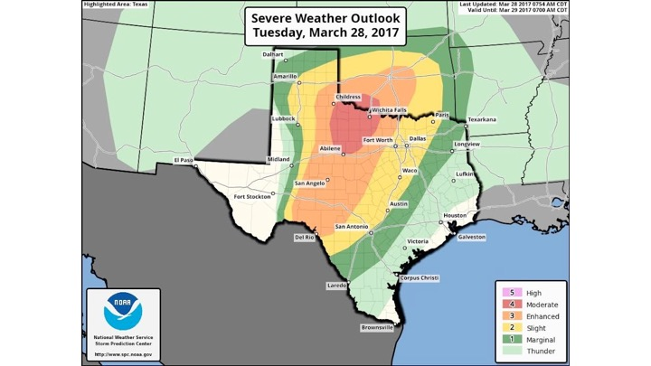
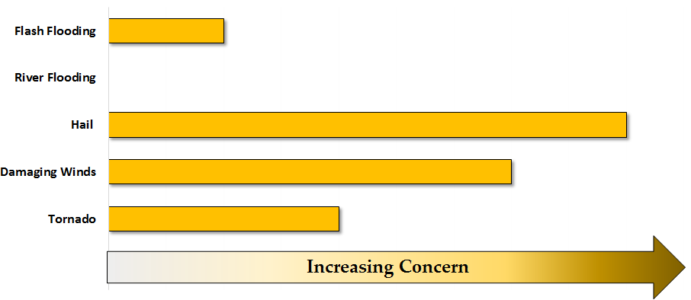
2 reports of hail (oops)
60+ wind reports (several over 80mph)
4 “brief” EF0-EF1 tornadoes

Slide 43
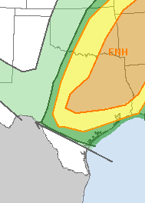
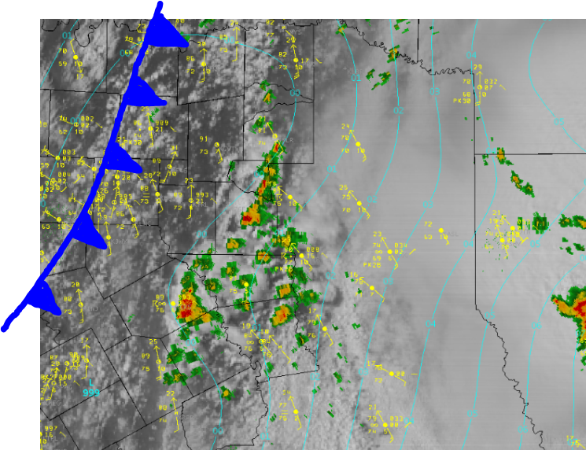
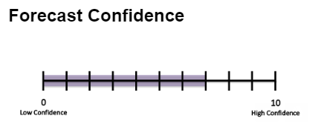
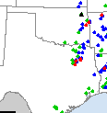
8 Hail Report
0 Wind Reports
9 Tornadoes (3 very bad ones)

Slide 45
Spring 2019 Review

Slide 46
Topics to be Covered
Background
Original Content
2018 Update
Media Partnership
3/13/19 Case Study

Slide 47
Background
Need for guidance recognized in 2008
Sought to provide a starting point for decision making
Non-binding guidelines
Approved by COG Executive Board in 2009
Updated in 2012 and 2018

Slide 48
Original Content
Explained purpose of outdoor warning sirens
Established weather activation considerations:
Tornado Warning (observed or radar indicated)
Damaging winds 70 mph or above
Hail 1.25 inches
Preserved right to deviate as needed for public safety

Slide 49
2018 Update
Increased hail size activation to 1.5 inch hail
Enhanced deviation language
Detailed how notification of activation is to be shared with media partners
Added media talking points section

Slide 50
Media Partnership
Improve understanding of siren activation
Assist media partners to quickly and correctly ascertain when, where, and why sirens are being activated
Commitment to share activation via NWS Chat

Slide 51
3/13/19 Case Study
Late night
Dynamic high wind threat
Activation decisions made by several jurisdictions consistent with the Framework
NWS Chat used to announce activations to NWS and media partners

Slide 52
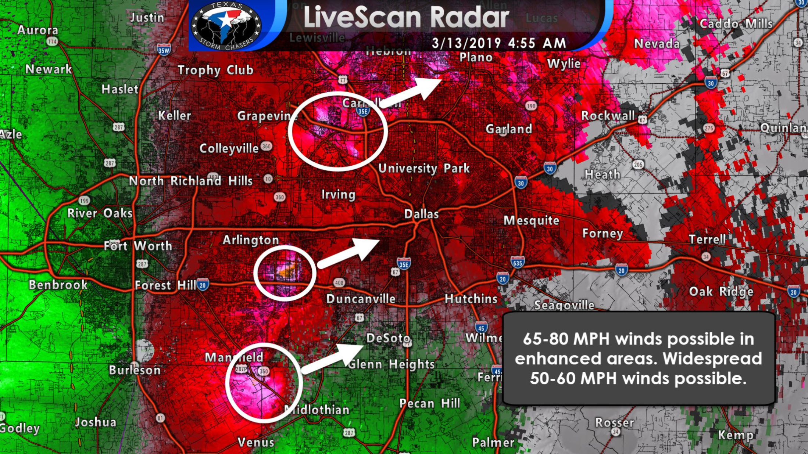
Source: Texas Storm Chasers Facebook Post

Slide 53
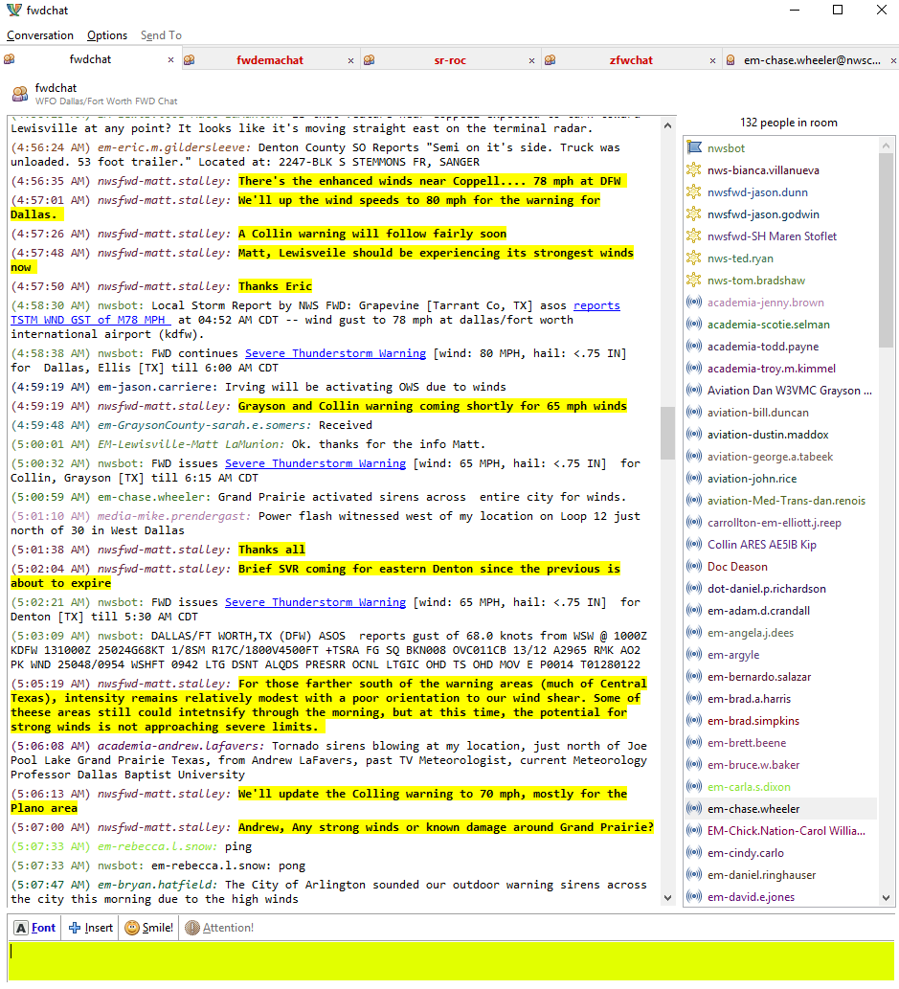

Slide 55
Summary
Sirens are all hazard.
Current weather activations considerations:
Tornado warning
Winds 70 mph or above
Hail 1.5 inches and larger
Jurisdictions can deviate as needed for safety
Media partnership to announce activations

Slide 56
Questions?

Slide 57
Break Time! 10 min.

Slide 58
NWSChat and Etiquette

Slide 59
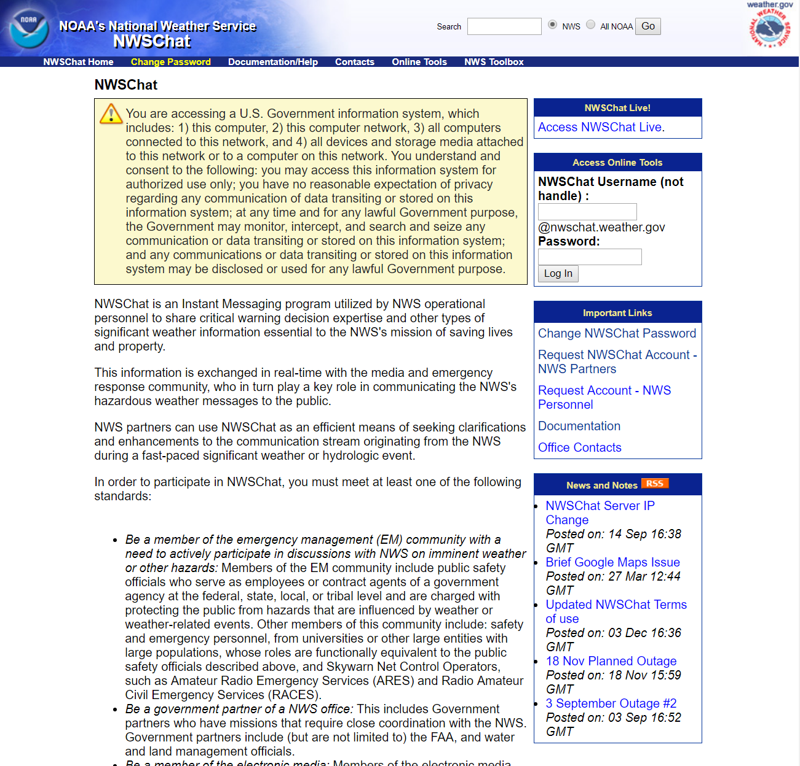
Where It All Begins: www.nwschat.weather.gov
New Account Requests are sent to me:
I vet each request I don’t recognize through local officials…usually the EM(s)
Please let me know if there is someone else I should ask
Have 30 days to approve or deny
Have to provide a reason for denial
You can save me time by sending me an email if you know someone in your jurisdiction is going to request a new account (yes or no)
Change your password every 180 days (required)
If you don’t by the deadline, you are locked out until you change it
Receive Head’s Up Emails from [nwschatadmin] starting a week or so before your deadline

Slide 60
Where It All Begins: www.nwschat.weather.gov
Complete your annual training
Doesn’t take long to complete
If you don’t by the deadline, you are locked out until you take it
Receive Head’s Up Emails from [nwschatadmin] starting a week or so before your deadline
Account is removed after lack of activity for 6 months
Signing in counts
Log in doesn’t change if you move, but you can change how your name is displayed in each room
Will need to update your email with Chat Admins

Slide 61
Who Can Have a Chat Account?
NWS
EM community
Media (broadcast mets, reporters, station directors/producers, radio, some newspaper)
Some Fire and Law officials (usually those who work with the EM community and/or spotter activations)
State, Regional, Federal agencies (TDEM, FEMA, DHS, etc)
HAM Net controllers (those who serve with the EM and/or during spotter activations)
Academia, usually associated with research

Slide 62
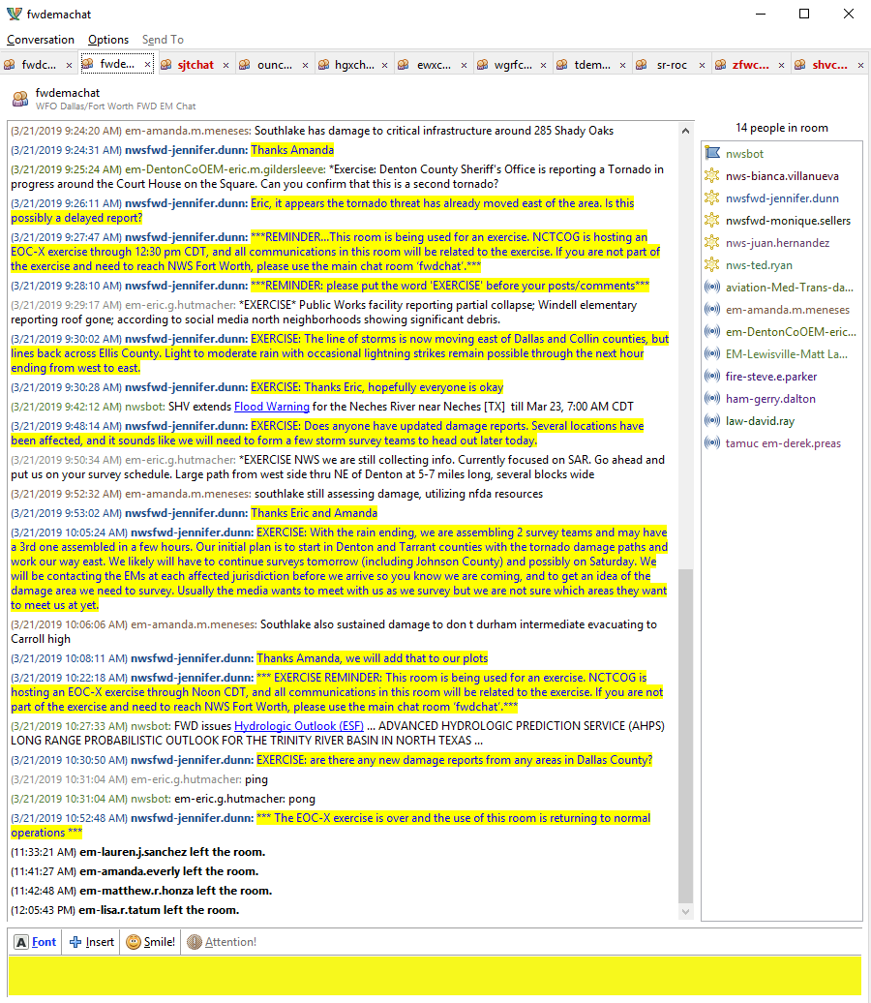
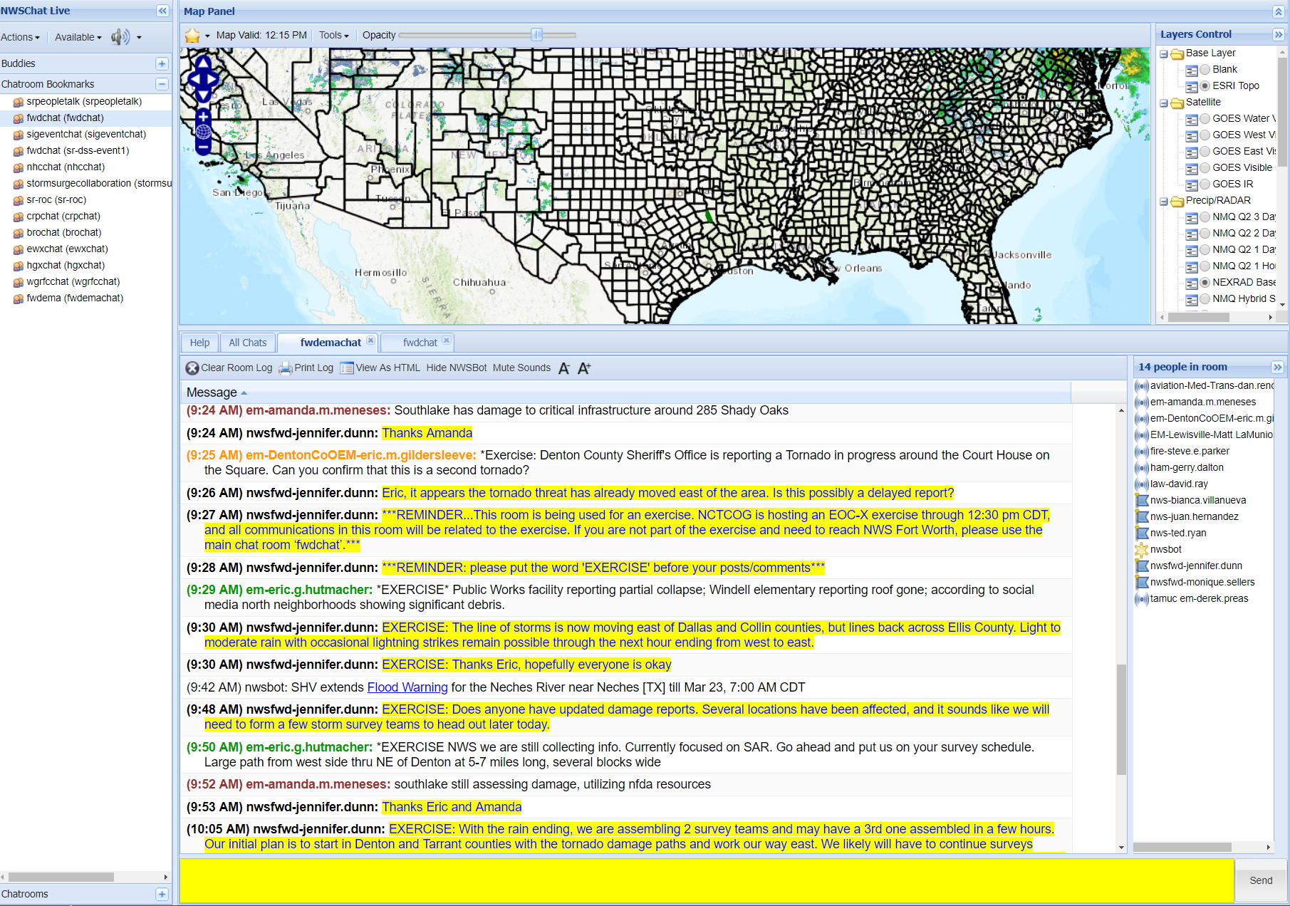
NWSChat Live vs Pidgeon
www.nwschat.weather.gov/live

Slide 63
Mobile Versions
Some mobile devices also support chat clients. While no support will be available for the mobile client software nor does the NOAA/National Weather Service endorse the following products, links are provided for informational purposes.
Octro (Windows Mobile)
WebMessenger (Windows Mobile and BlackBerry)
Vayusphere (BlackBerry)
imov XMPP Messenger (Beta) on the Android Market or Jabiru (at http://jabiru.info/)
iPhone Applications, ensure the application you select can support XMPP protocol and group chat
Talkonaut & BoogieChat

Slide 64
2 Chat Rooms: fwdchat & fwdemachat
You automatically have access to ‘fwdchat’ when your account is created
EMs (only) request access to ‘fwdemachat’ through Jennifer Dunn
Hidden chat room you have to manually search for it
History: EMs have asked us to keep the ‘fwdemachat’ room as a “safe place” to share sensitive information
NWS and IWT encourages as much interaction and questions/answers/reports/etc in the main chat room = fwdchat
Our office may soon stop copy-and-pasting into ‘fwdemachat’; all our posts go into ‘fwdchat’ already
Notes:
Don’t copy
Auto access to fwdchat

Slide 65
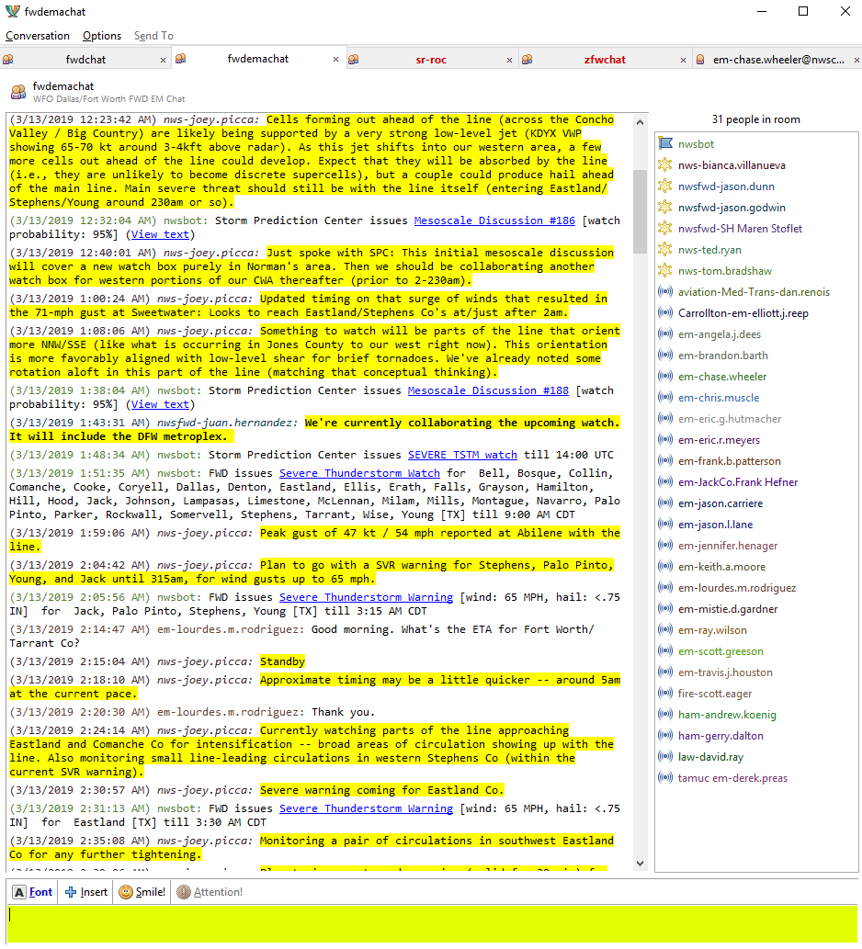
NWSChat in Action: March 13, 2019
Notes:
We highlight

Slide 66
Rules and Suggestions
Change your handle in both rooms (can be different)
EM-Jennifer.Dunn vs EM-Terlingua-Jennifer.Dunn
Don’t get offended if we don’t respond to you with your real name if it’s not in your handle (i.e: EM-Terlingua)
Encourage most communication in the main chatroom: fwdchat
EMs = Reserve the most sensitive information for the fwdemachat room
If it’s sensitive information you don’t want shared yet, state that! (in both chat rooms)
Don’t be afraid of sounding silly or asking “silly” questions…everyone give grace!!
Civil disagreements are fine, but no arguing
Avoid private chatting NWS, if possible
Each NWS forecaster monitors 8+ chatrooms at any one time, and we may not notice a private chat in a timely manner

Slide 67
Help Us Help You
Your damage reports help us!!
Don’t be afraid to post (or send) any and all damage reports!!
You will not overload us!
Don’t assume we already know!
It’s our JOB to collect and filter through the reports
Email damage info to sr-fwd.webmaster@noaa.gov, Jennifer Dunn or one of the forecasters if you coordinate that with them
We will post our survey plans in ‘fwdchat’
We will post our survey results in ‘fwdchat’ once we clear it with the local officials

Slide 68
NWSChat is a GREAT Tool!
Widely accepted and used across the region
Monitored 24/7 with a goal of responding within 5 minutes (from NWS)
Ask questions at any time, even quiet weather
NWS assigns one person to be the “chatter” during every event
Some forecasters chat more than others

Slide 69
Questions / Discussion

Slide 70
Spotter Activation

Slide 71
NWS Fort Worth’s Policy
NEW: Severe Storm Notification pages
Sent ahead of all Severe Thunderstorm (and Tornado*) Warnings, when possible
Will not be sent if not able to send before the warning…the warning serves as your notification
Hopefully gives you advanced notice of possible severe weather and allows you time to activate your severe weather action plans
Doesn’t guarantee a warning
Your severe weather action plan may involve activating spotters
We still want reports!!!
Reasons for the change
Research showed spotters aren’t always being activated when ‘Spotter Activation’ pages were sent by the NWS…sometimes it’s a judgement call
Inconsistency among our staff over the term “spotter activation”
Inconsistent activations; in particular for marginal events, during the night
Allows our staff to all be on the same page with our notification policy

Slide 72
Severe Storm Notification
“The NWS is becoming concerned about the potential for severe weather in your area. A warning may be needed. We would appreciate any reports you can send to our office through any methods.”

Slide 73
Spotter Activation Notifications
Still have a “Spotter Request” notification for instances that we think spotters will help our warning decision making process…most likely for rotation and tornadic activity:
“The NWS is increasingly concerned about the potential for tornado development in [location]. We would appreciate spotter deployment if possible”

Slide 74
What about Amateur Radio and Net Controllers
We will continue to call-in our volunteer amateur radio team to the office in the same manner in which we always have (won’t be calling them in any less)
However, when we don’t have the team in, use NWSChat or a phone call to send us reports
Follow-up with your net controllers/spotter groups/etc about the expected protocol with this message change
Recommendation: 1) If you used to always activate spotters when you got a notification from the NWS, continue to activate them if you want that to still be part of your severe weather action plan 2) If you used to make a judgement call, continue to do that

Slide 75
What Reports Does the NWS Want?
Tornadoes, or signs that one may be developing
Funnel clouds, strongly rotating wall clouds, etc.
Flash Flooding: rapidly rising water into areas that do not typically flood
Hail: larger than ¾ inch in diameter (i.e. penny-sized or larger)
Damaging Wind: damage caused by thunderstorm wind gusts or measured winds of more than 50 MPH
Notes:
Add ways to get reports to us aside from chat

Slide 76
How Can You Send Reports To the NWS?
Amateur radio
NWSChat
Phone: 1-800-792-2257, operational (unlisted) numbers
Social Media: good way to send pictures, but may not be seen in real-time
Twitter: @NWSFortWorth, #dfwwx, #ctxwx
Facebook: www.facebook.com/NWSDallasFortWorth
mPing: mobile app for reporting severe weather (as well as winter weather)

Slide 77
Questions / Discussion

Slide 78
Break Time! 10 min.

Slide 79
SEVERE WEATHER 101 WORKSHOP
Is Your Community Ready?

Slide 80
Introduction:
The goal of this presentation is to provide a walk-thru of a severe weather event in a brief timeframe
The event slides will be followed with question slides
The questions apply to all groups in attendance
The goal of this presentation is to facilitate a discussion on the severe weather response process here in North Texas

Slide 81
Monday-Tuesday
Scenario:
Monday and Tuesday morning you receive an e-mail from the National Weather Service regarding weather potential for Friday evening/night. The e-mail states there is the potential for rain, gusty winds. Confidence scale is a 6.

Slide 82
Questions:
Based on the information, what do you do?
What are your concerns?
Any additional items?
Notes:
Based on the National Weather Service’s presentation, what do you do? (One of the correct answers is: send out e-mail updates internally, externally, cancel date night, etc.)
What do you use to send out notifications? (i.e. Everbridge, e-mail, text) Why?
Who do you send notifications to? Does the severity of the event affect who/how many ppl you send notifications to? (i.e. send to more ppl if the severity is higher?)

Slide 83
Wednesday-Thursday
Wednesday and Thursday’s email updates from the National Weather Service include “strong to severe” and the confidence is increasing in the forecast. The phrase “cannot rule out an isolated tornado” is also included at this point, however, the forecast is focused on the flash flooding, damaging winds and hail.

Slide 84
Questions
Based on the additional briefing what are you doing differently, if anything?
What are your concerns?
Any additional items?
Notes:
Based on the National Weather Service’s previously awesome presentation and as a professional emergency manager, what additional actions do you take? Why?
What sections of the NWS e-mail update are most important to you? What do you look at first? What are the key words you are looking for? What actions will you take based on said key words?

Slide 85
Friday
Game Day. Friday morning. You arrive at your office to find the National Weather Service final e-mail update which informs you that the system will be in your jurisdiction around 5pm. The threats remain the same (heavy rain, damaging winds, hail and the iso-tornado). You have outdoor events going on throughout your jurisdiction during this time frame.
Notes:
Based on the National Weather Service’s previously awesome presentation and as a professional emergency manager, what additional actions do you take? Why?

Slide 86
Questions
What plans/actions have changed since the last brief?
What are your concerns?
Any additional items?
Notes:
What do you do now? (answers may range from nothing to providing e-mail updates to running a silent test on the OWS)
How many jurisdictions hold a quick briefing for weather events like these? Are they helpful?
Who are your “must haves” during severe weather events for your EOC and jurisdiction? Staffing needs?
Anything we haven’t discussed that you are doing to prepare for the weather event?
How many jurisdictions know who to call at their ISDs for severe weather events?

Slide 87
Friday, Late Afternoon
Scattered showers and non-severe storms have entered the area ahead of the main system.
NWSchat provides an update that the line is still off to the west and is expected to fire up as it nears Wise and Parker counties.
Notes:
EMs, what do you use besides NWSChat to maintain SA?

Slide 88
Questions
What are you monitoring? Why?
Where are you? Why?
Who are you informing in real-time of the storm event?
Notes:
What are you monitoring? Why?
Where are you? Why? Follow up with: If you’re not at the EOC do you go in to the EOC knowing you will be out-of-the-loop (time & intel) during the commute?
Who are you informing in real-time of the storm event?

Slide 89
Storm Line Approaches
The National Weather Service is posting in NWSChat they are growing concerned about the cell headed for your jurisdiction. The cell is approximately 45 minutes away and it takes about 45 minutes to evacuate the outdoor events. There may be a need to provide notification to the public, including the outdoor events.
The National Weather Service mentions that if the storm continues to intensify they will need to issue a warning for the neighboring jurisdictions west of your location.
Notes:
The following questions will have varying answers depending on how widely recognized and integrated EM is in their community. If EMs do not have working relationships with their “stakeholders” we need to highlight the importance. Trust + confidence, and well, trust = people taking their EMs seriously. How far we go into that equation will be contingent on the interest from the audience.
Are you in contact with the ISDs? Do you help them make decisions? If not, do they have a POC in contact with NWS? Do you know?
Do you have Nixel groups set up to warn out-of-town visitors at your events?

Slide 90
Questions
Based on the information, what do you do?
What are your concerns?
Any additional items?
Notes:
What do we do now?
Are you in contact with the ISD and stadium? Any special events?
Are you in contact with PD/FD/Pub Works?
What is your common operating picture/situational awareness telling you? (what tools are you using to monitor information, share information, with who, why, etc.)

Slide 91
Thunder Truck
Brian James in the Thunder Truck reports golf ball size hail to baseball size hail just to the southwest of your jurisdiction. A spotter reports a cell to the southwest of your jurisdiction showing signs of organized rotation.
Social media is “blowing up” with scary cloud pics displaying what appears to be low hanging scud. NWS issues a Severe Thunderstorm Warning for your jurisdiction.
Notes:
The following questions will have varying answers depending on how widely recognized and integrated EM is in their community. If EMs do not have working relationships with their “stakeholders” we need to highlight the importance. Trust + confidence, and well, trust = people taking their EMs seriously. How far we go into that equation will be contingent on the interest from the audience.

Slide 92
Questions
Based on the information, what do you do?
What are your concerns?
Any additional items?
Notes:
Where are you at now in your process? (have you made your calls to ISD/stadium folks, FD, PD, out on the ground, dispatch?).
Would an update be necessary for your jurisdiction given the circumstances? Would anyone be caught off guard at this point?
How many warning streams are automated for your jurisdiction vs. manual warning streams? Readywarn, Everbridge, etc. have the capability of automatically pushing out NWS warnings and other streams (i.e. text to your fire chief and other departments) may not be. How does this effect your workload?
Given the new siren rules, do you see any reason to activate your OWS at this point? – do you have a threshold or specific number of ppl that need to be present to lower OWS warning criteria?

Slide 93
Vancouver, Vancouver -- this is it!
The NWS issues a tornado warning as the storm arrives in your jurisdiction. One spotter reports seeing a rotating wall cloud near Main Street. Dispatch begins to receive calls for arcing power lines and several motor vehicle accidents that may be related to hydroplaning or high winds. Other damage reports start coming in.
Notes:
The following questions will have varying answers depending on how widely recognized and integrated EM is in their community.

Slide 94
Questions
Questions:
What do you do now?
Who are you calling to inform there is storm damage?
What are you asking them to do?
Where are you asking to them to show up? When? Why?
Notes:
Questions:
What do you do now? (go out and look at it? Or stay and log 9-1-1 calls to record their addresses & plot on a map?)
Who are you calling to inform there is storm damage? What are you asking them to do? (call them with what you know, send a place holder: “there’s storm damage, still gathering info, briefing to follow” or keep gathering info? I suspect this will be contingent on culture of jurisdiction.)
Where are you asking to them to show up? When? Why? (how long do you need to gather the info – if more time is needed, how do you manage those expectations from your higher ups and stakeholders?

Slide 95
It’s Been a Hard Day’s Night…
Whilst logging 9-1-1 calls you are listening to your radio, which is busy reporting damage to homes, large trees and vehicles called in by fire apparatus responding to the area. You are on the phone, computer and radio gaining more and more information that is showing a significant event has impacted your jurisdiction.
Notes:
Are you mobile, in the office or at the EOC?
When do you call for help at the EOC?
PIO’s when do you reach out to your EMs?

Slide 96
Questions
Who are you requesting at this meeting? Why?
What is your plan of attack? Why?
How are you maintaining your workload? (not missing any info?)
Notes:
Who are you requesting at this meeting? Why? – (finance, fire, police, public works, PIO, city management, etc.)
What is your plan of attack? Why? (which roads get cleared first? Check on residents in damaged homes, etc.)
How are you maintaining your workload? (not missing any info?)
What does your briefing cover?
What is your operational period?
Debris management?
Public information?
Curfews or extra patrols?
What special considerations are needed?
Are you running ICS, departmental or ESF EOC operations?

Slide 97
Next Steps
Gathering damage assessments
Mapping
Completing the DSO
Regional Support
Notes:
How do you determine the need for and initiate damage assessments?
Here’s what you know:
Actions taken by fire and police
According to the map based off of the damage reports, the path appears to be similar to that of a tornado and spans multiple city blocks.
Several homeowners have been displaced as a result.
Major roadways have been cleared of the majority of debris except for several downed power lines.

Slide 98
Q&A
SEVERE WEATHER
101

