Slide 1
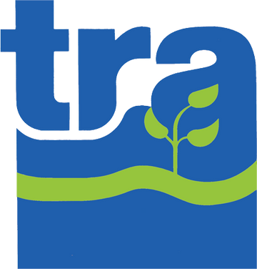
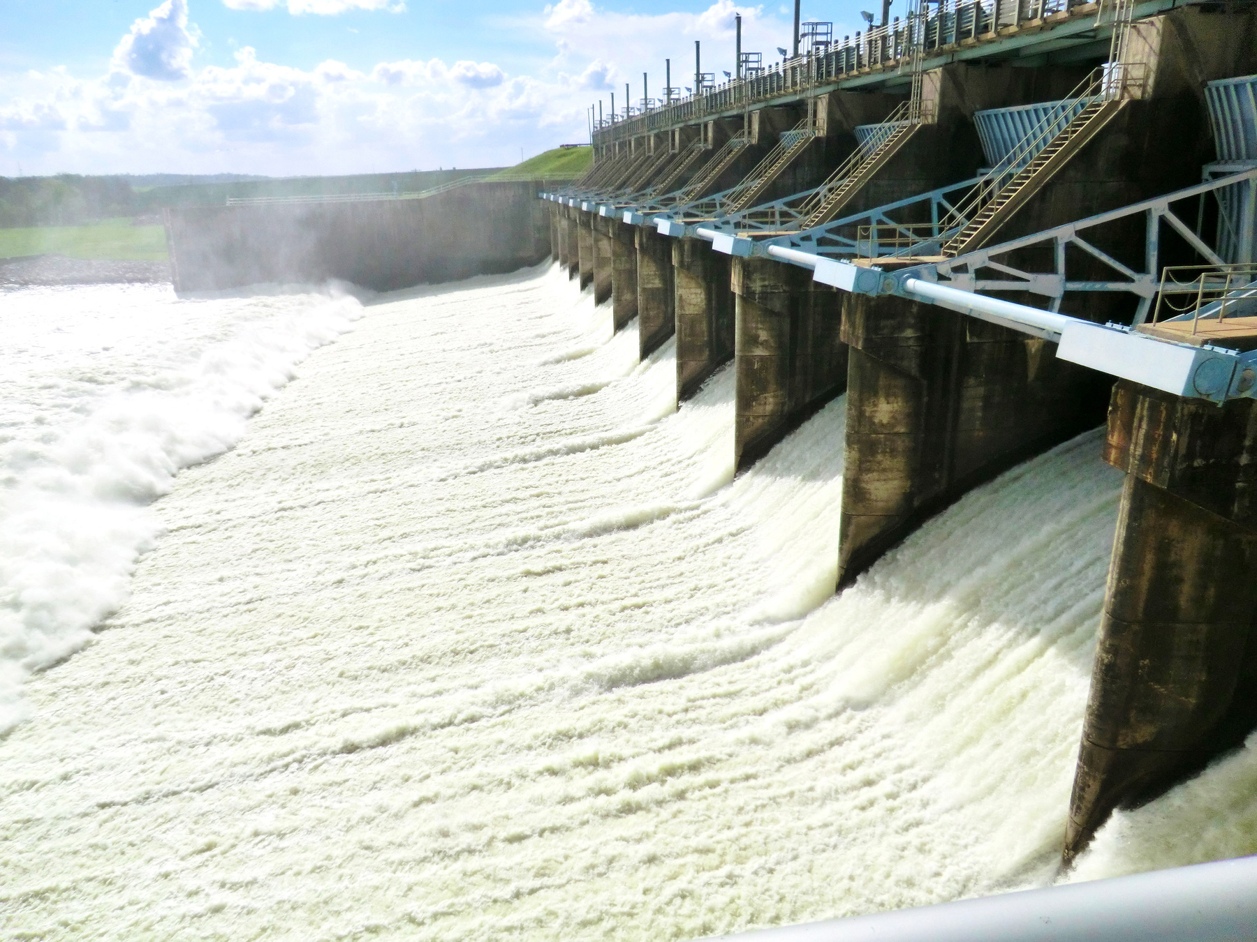
TRINITY RIVER AUTHORITY OF TEXAS
Welcome to TRA’s Central Regional Wastewater System (CRWS)!

Slide 2
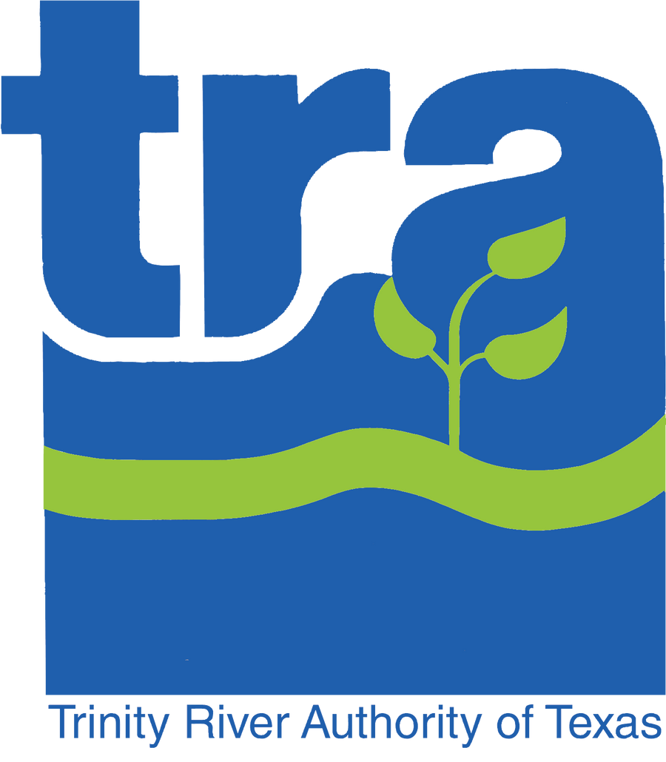
Who is TRA?
Largest wholesale provider of wastewater treatment services in Texas.
Specializes in development and operation of multi-participant regional facilities.
TRA provides water and wastewater treatment, along with recreation and reservoir facilities for cities within the nearly 18,000-square-mile Trinity River basin.

Slide 3
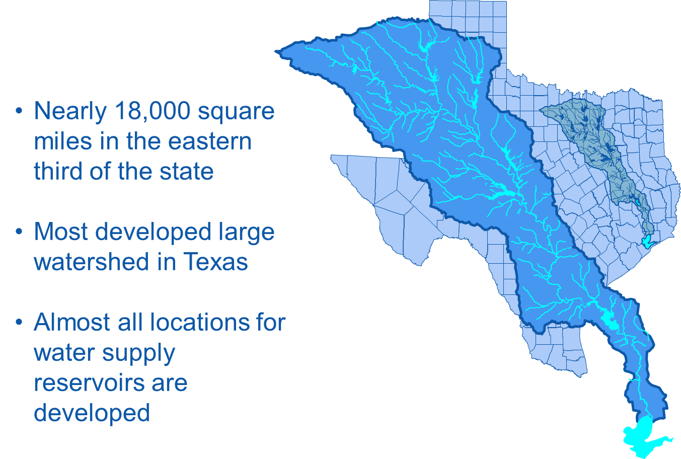
Trinity River Basin

Slide 4
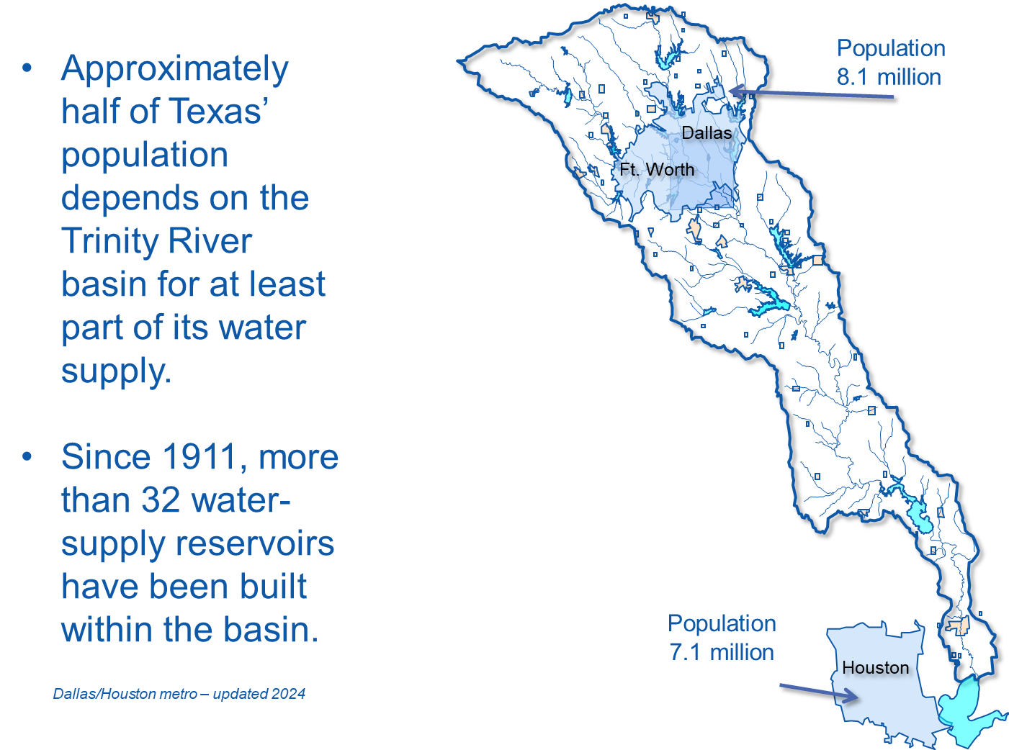

Slide 5

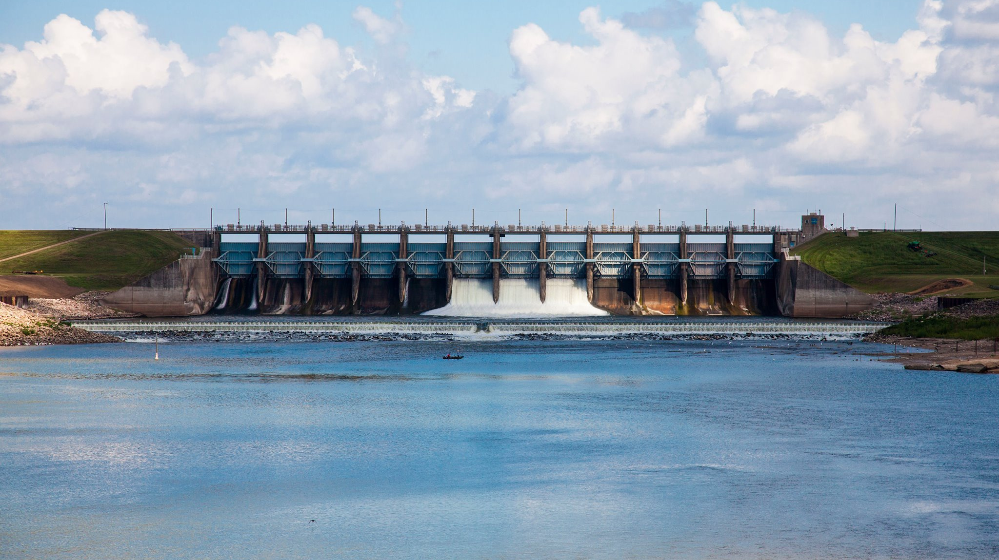
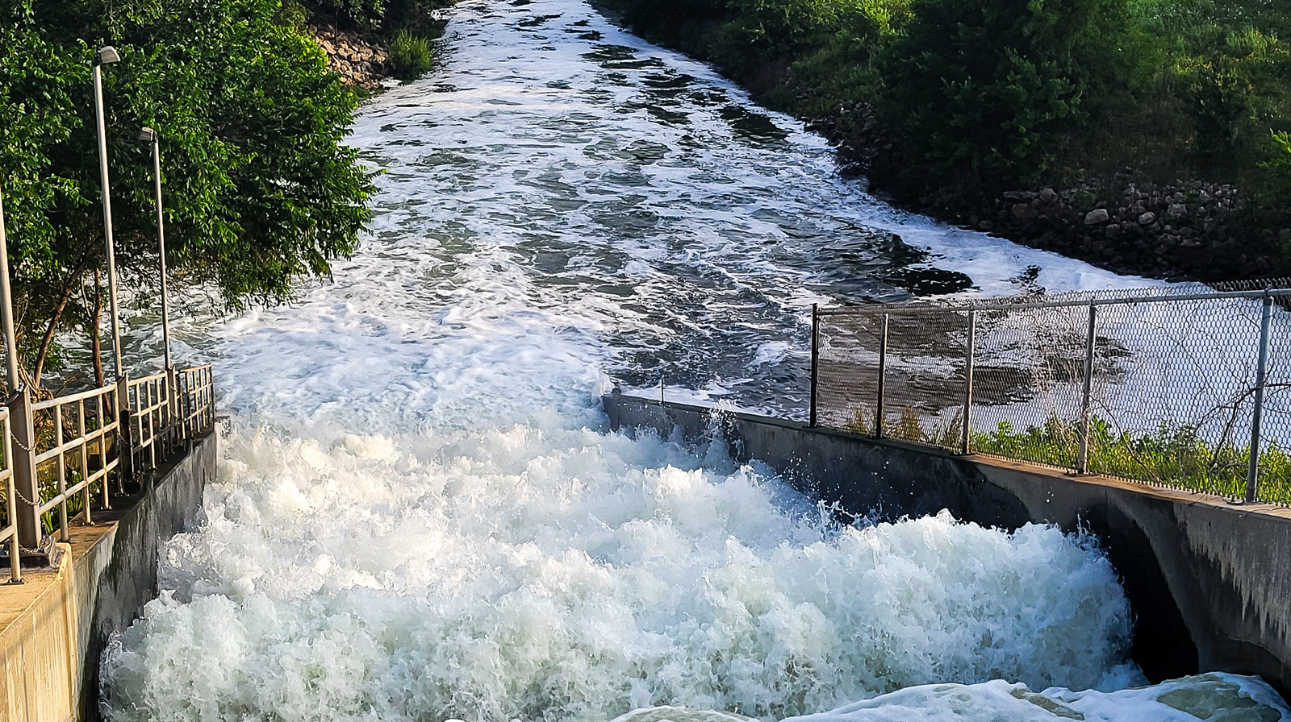
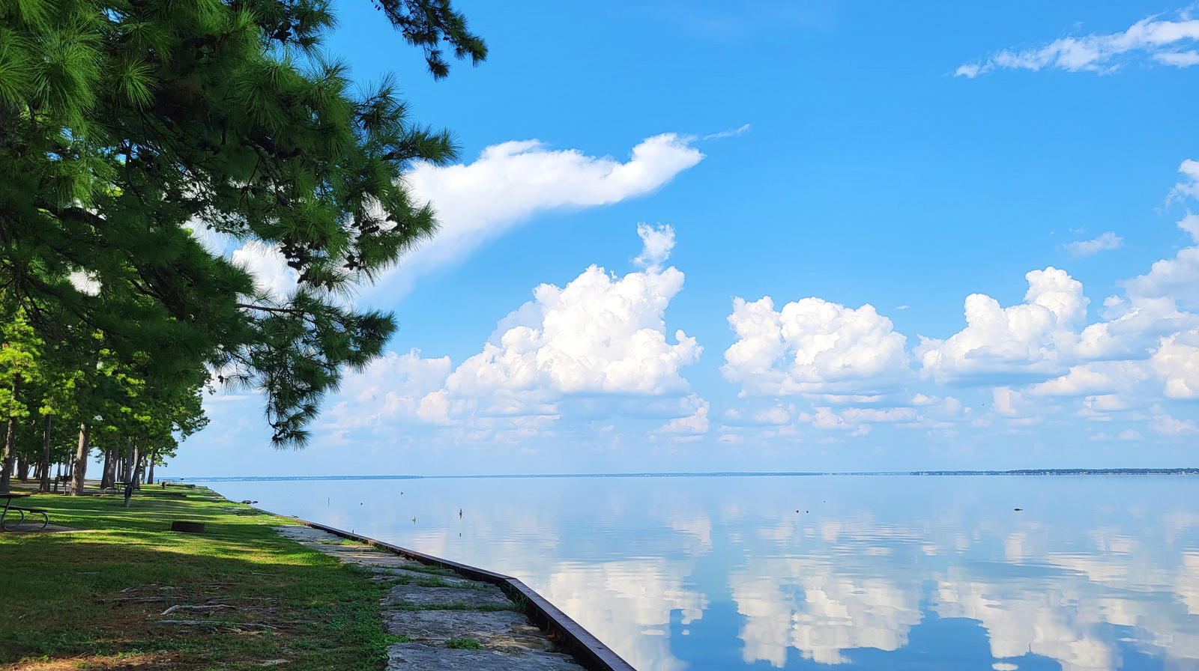
WATER
RESERVOIRS
All TRA Services
WASTEWATER
RECREATION

Slide 6
Central Regional Wastewater System

Slide 7
Central Regional Wastewater System
Lake
Lewisville
Service Area
Trinity River Basin
121
Carrollton
114
Grapevine
Lake
Coppell
Addison
Fort Worth
Keller
Southlake
Grapevine
North
Lake
Dallas
Farmers Branch
Colleyville
D/FW Airport
N. Richland Hills
Dallas
Bear Creek Interceptor System
Elm Fork Interceptor System
Bedford
Euless
Fort
Worth
Irving
Contracting Parties
CRWS Treatment Plant
Irving
Grand Prairie
Farmers Branch
Dallas
Carrollton
Arlington
Bedford
Euless
D/FW Airport
Mansfield
Grapevine
Colleyville
N. Richland Hills
Hurst
Coppell
Fort Worth
Keller
Duncanville
Cedar Hill
Southlake
Addison
1957
1957
1957
1957
1967
1973
1973
1973
1973
1973
1974
1975
1975
1975
1976
1976
1984
1984
1985
1988
1996
West Fork
Interceptor System
30
Jefferson Tunnel
Interceptor System
Dallas
Lake
Arlington
Grand Prairie
Mountain Creek Lake
20
Arlington
Mountain Creek Interceptor System
Joe Pool Lake
Mansfield
Cedar Hill
Notes:
This is the service area for TRA’s Central Regional Wastewater System. When created by contract in1957 it was the first truly regional wastewater system in Texas. It began operations in 1959 with four contracting parties and a 30 MGD trickling filter wastewater treatment facility. It has evolved in stages to a 162 MGD activated sludge facility that provides service to all or part of 20 cities plus the DFW Regional Airport.
All influent to the TRA collection system is measured by meters to determine what pro rata share of both debt and O & M is owed by each individual customer entity. As the customer flows increase and decrease relative to other system customers, so does their pro rata share of costs.
See the list of customers served in lower left corner of this image.

Slide 8
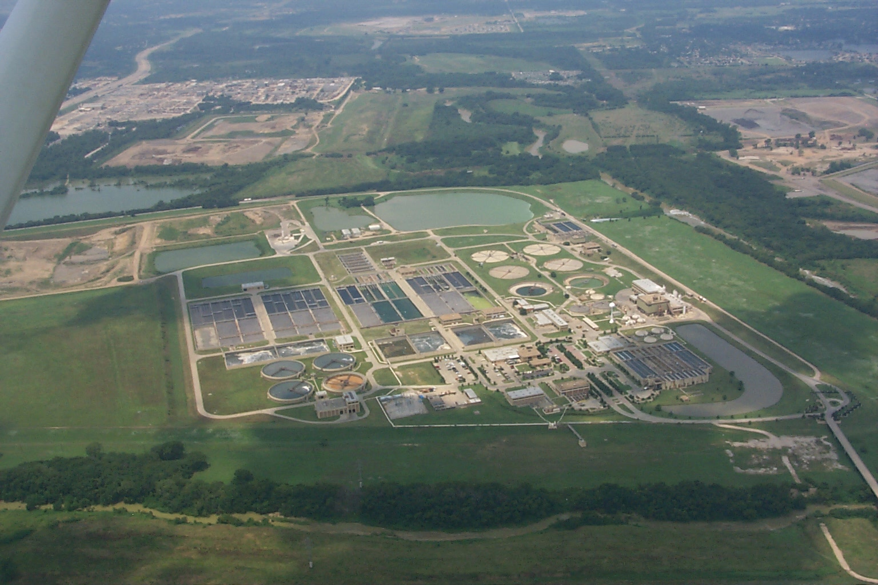
Central Regional Wastewater System
Began Service: December 1959
Current Capacity: 189 MGD
Annual Average Daily Flow: 143 MGD
Number of Contracting Parties: 21
Notes:
The CRWS treatment plant is able to consistently treat wastewater to a 99 percent level of purity compared to the raw product that is introduced into the treatment process. An activated sludge treatment process is the primary means of achieving this level of success.
50.7 billion gallons treated during FY 2010.
The Trinity River Authority’s Central Regional Wastewater System celebrated a momentous achievement on Sept. 19, 2013 when General Manager Kevin Ward announced that CRWS had treated and discharged ONE TRILLION GALLONS of wastewater during a 21-year period without any permit violations. “This is a celebration that we all have been anticipating, and we believe that CRWS is the first sanitary sewer system to have achieved this major milestone, which is a tremendous accomplishment in our industry,” said TRA General Manager Kevin Ward.

Slide 9
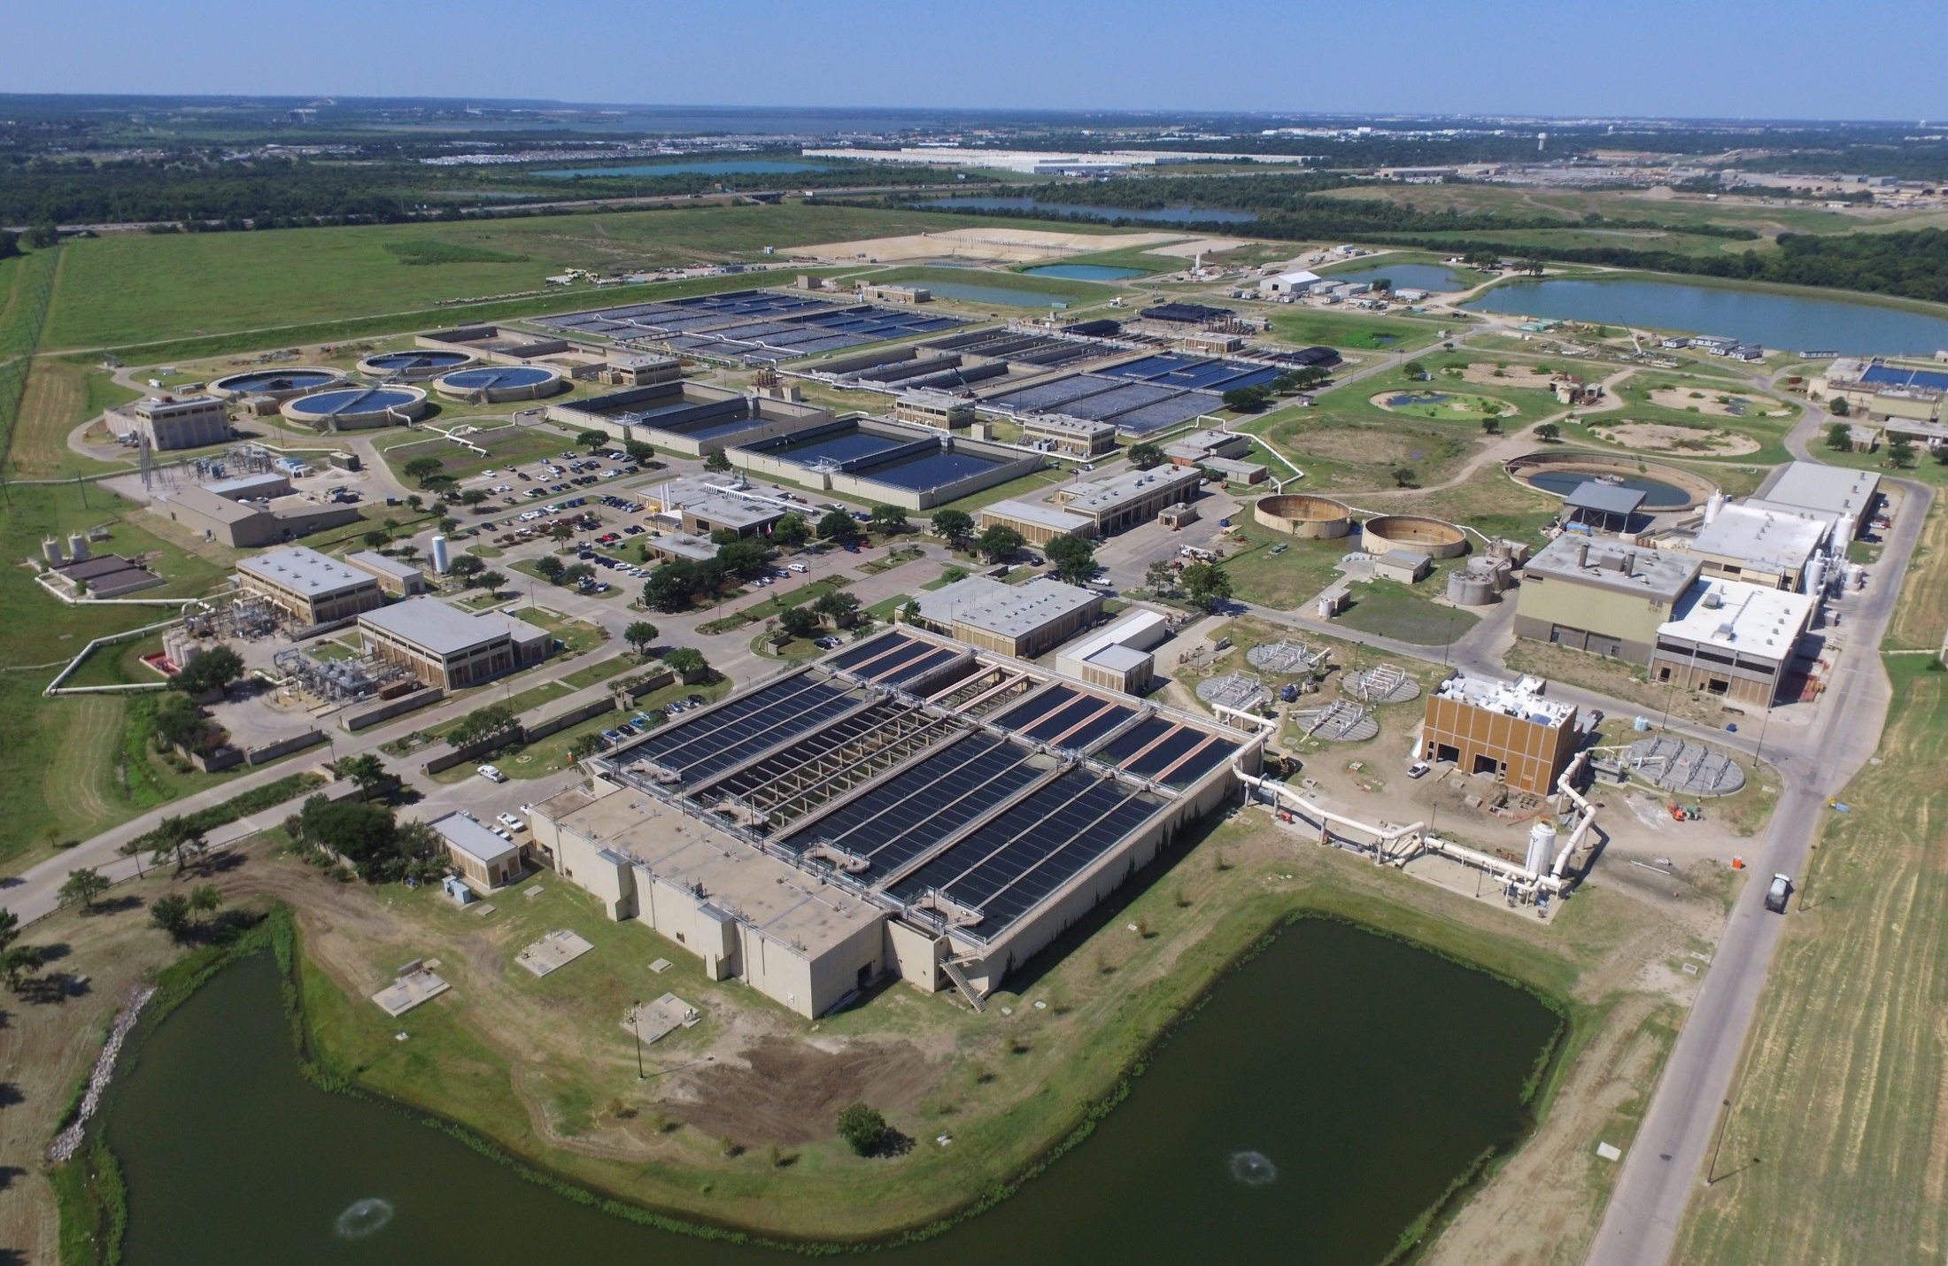
Preliminary Treatment

Slide 10
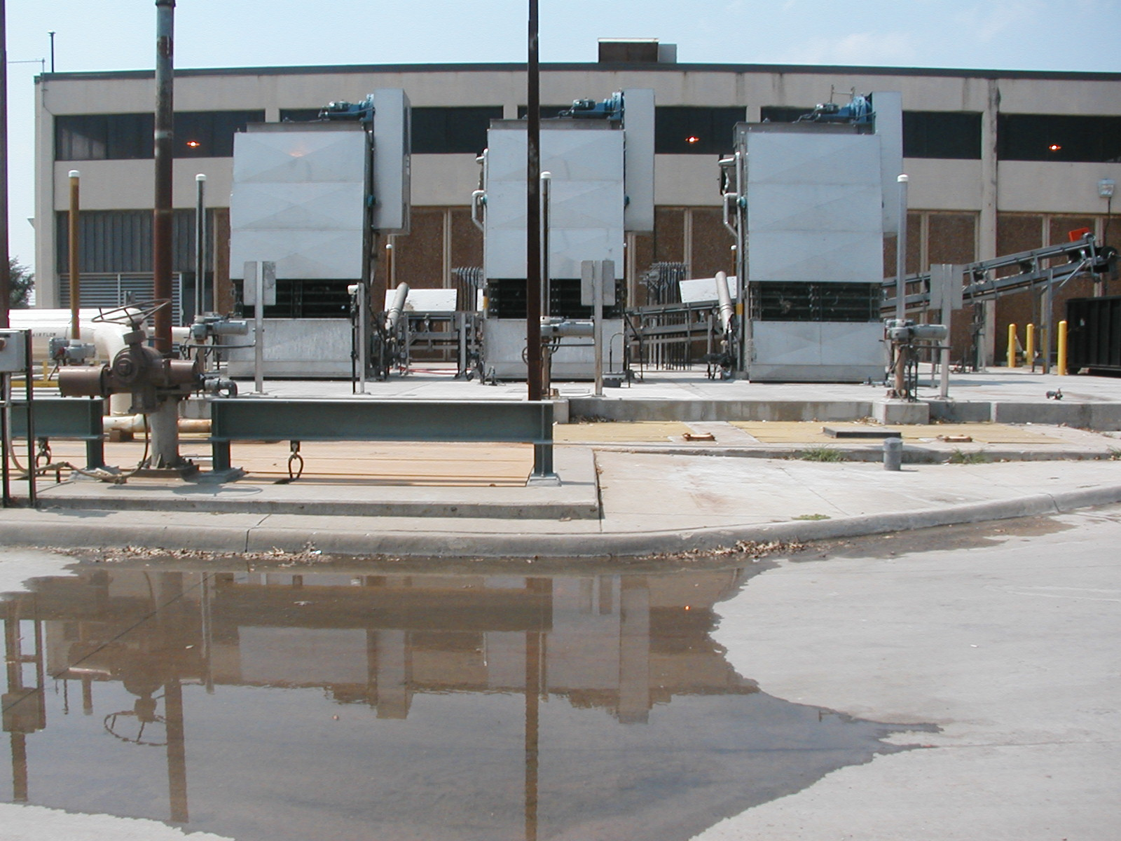
Initial Fine Bar Screens
Debris removal
Trash
Plastic
Equipment protection

Slide 11
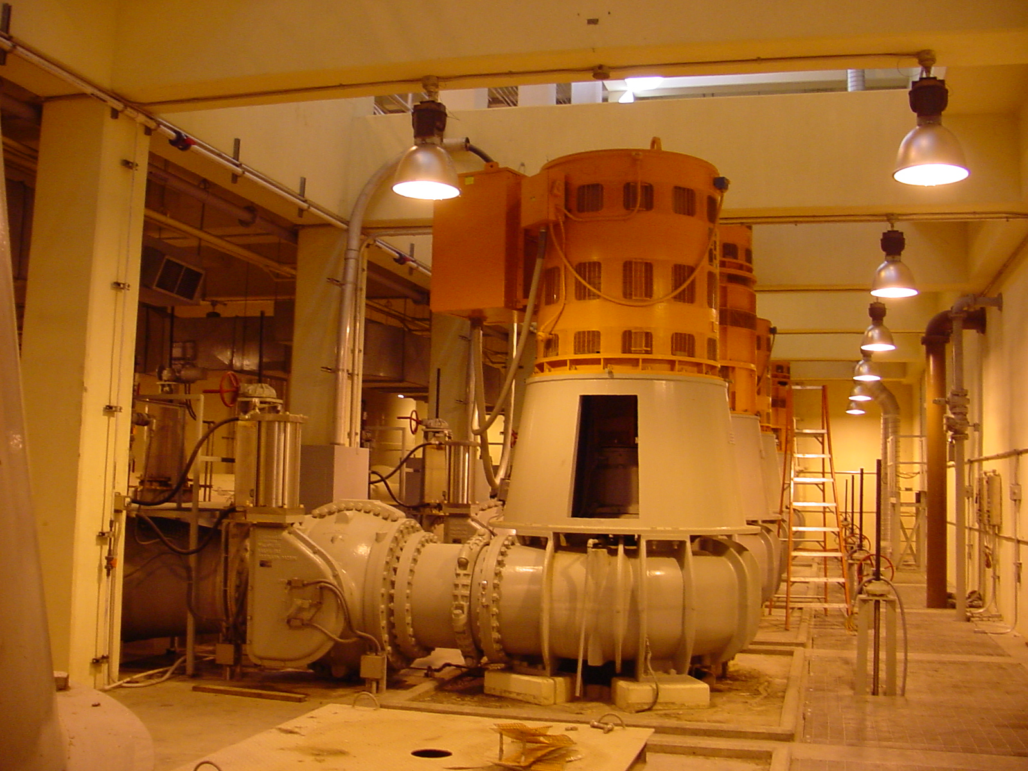
Pump, 900 Horse Power, 48 MGD (33,000 GPM)

Slide 12
Primary Clarification

Slide 13
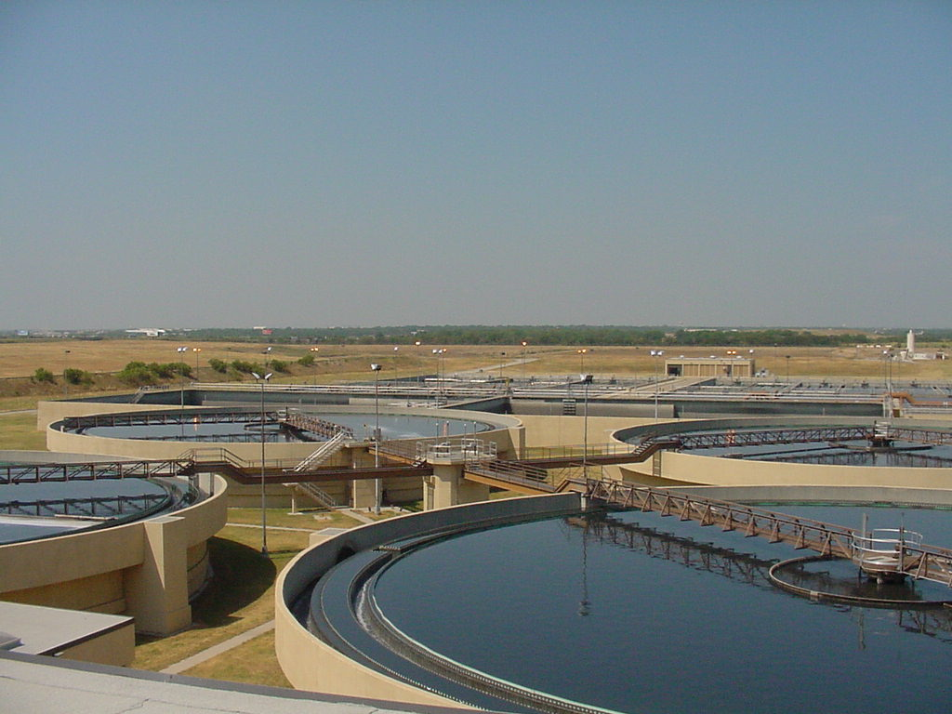
Circular Primary Clarifiers

Slide 14
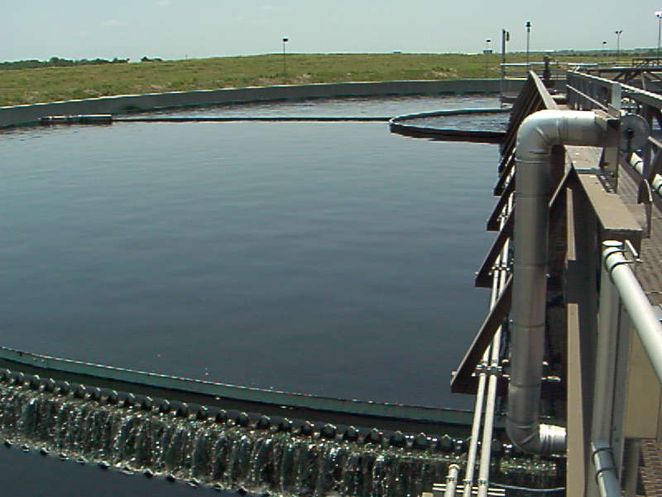
Primary Clarifier Weir Overflow

Slide 15
Activated Sludge Process

Slide 16
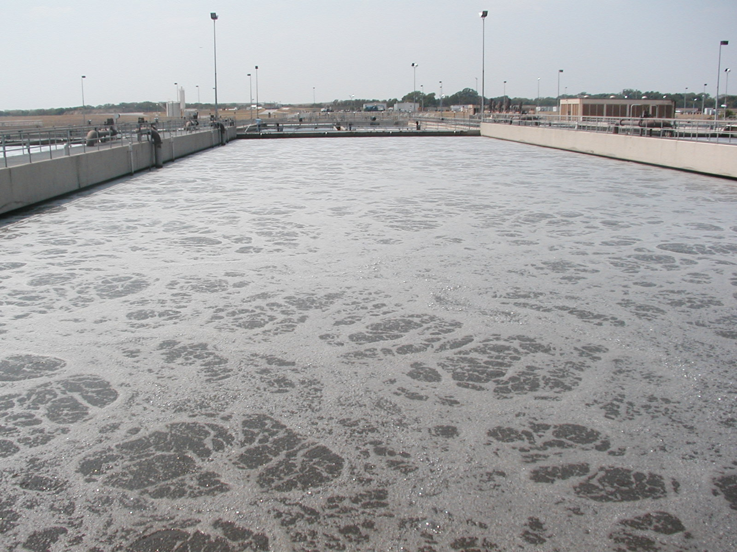
Activated Sludge Basin
BOD Removal
Ammonia
Phosphorous
TSS
Heart of liquids treatment

Slide 17
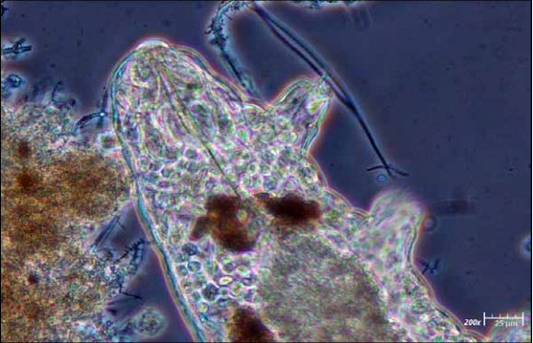
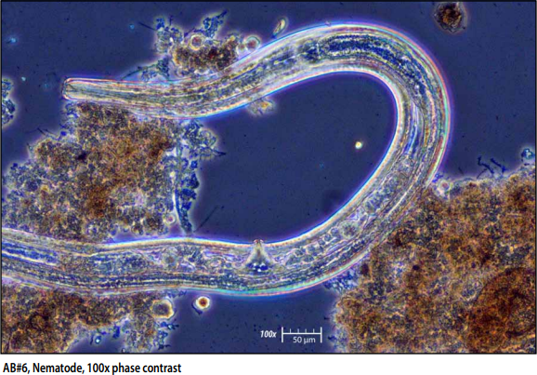
Water Bear (left) Nematode (right)

Slide 18
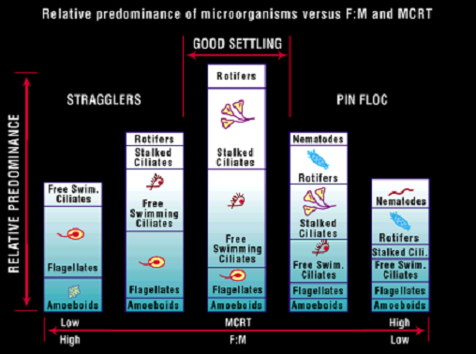
Wastewater Indicator Bacteria

Slide 19
Secondary Clarification

Slide 20
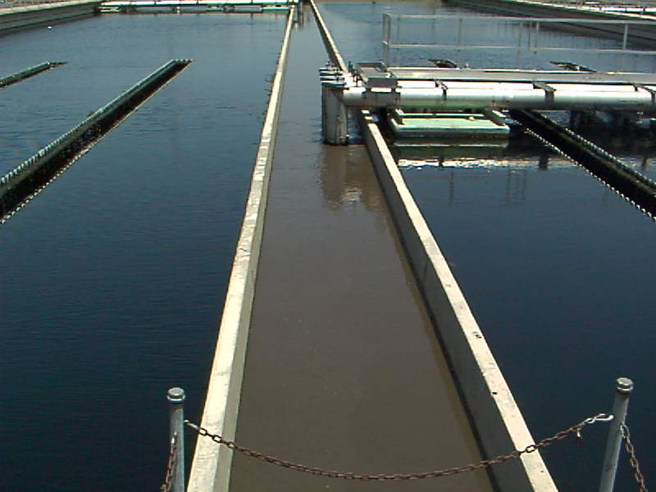
Settled Solids from Clarifier

Slide 21
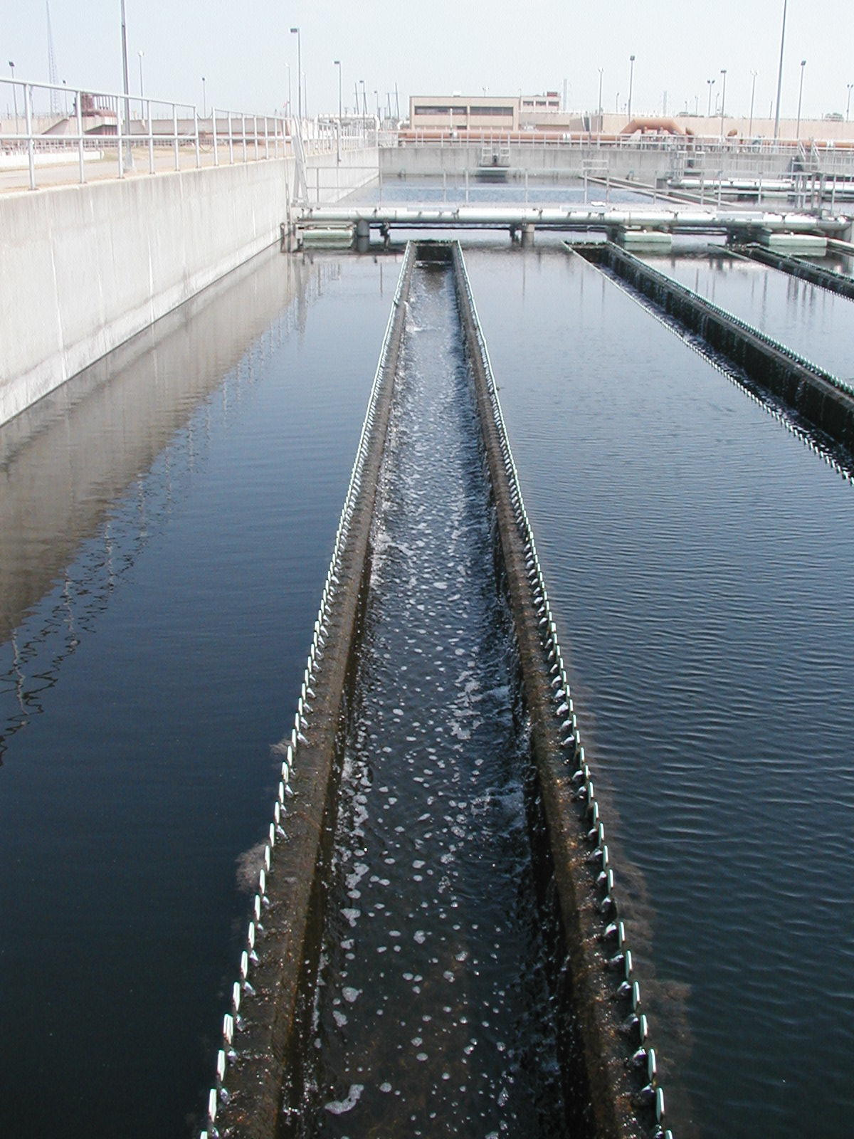
Final Clarifier Overflow

Slide 22
Tertiary Filtration (Polishing)

Slide 23
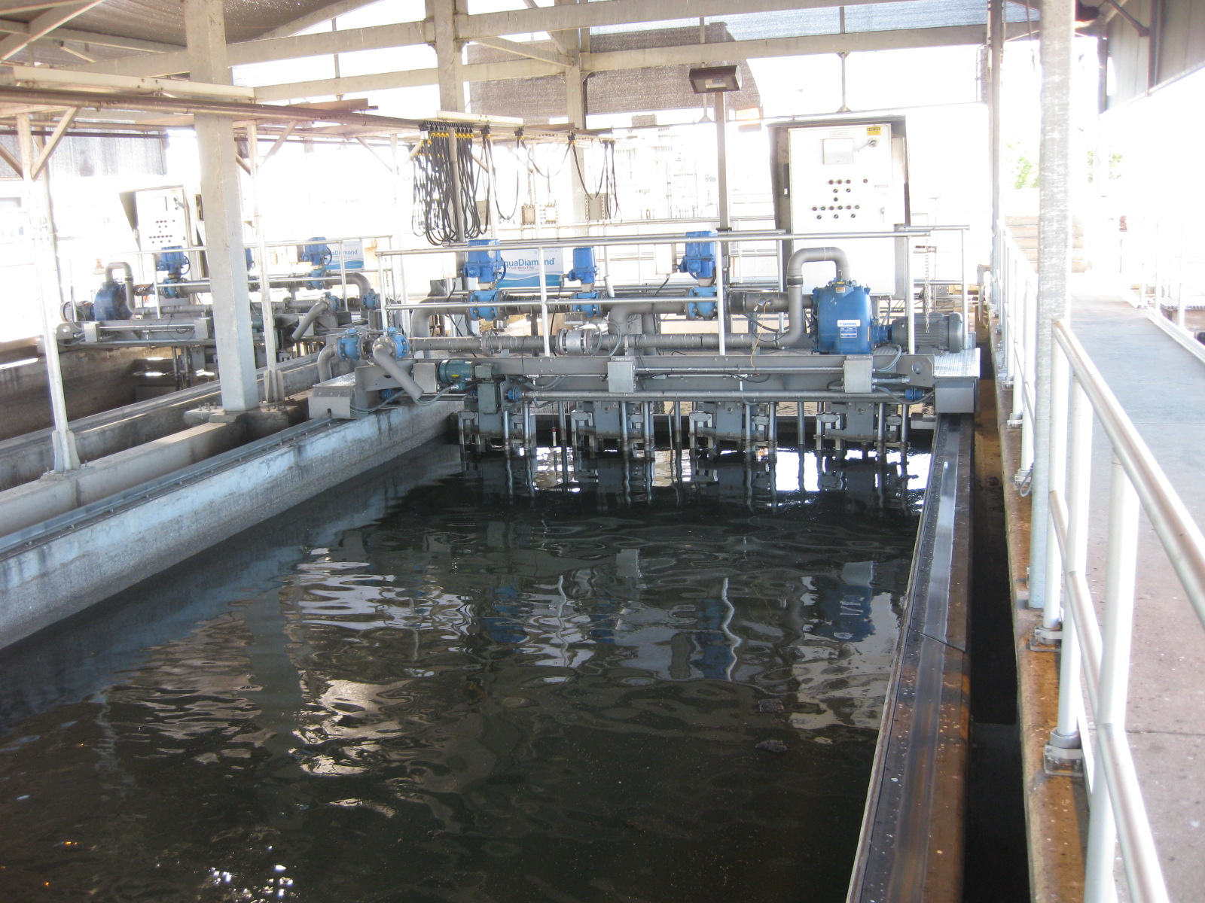
Aqua Diamond Filters

Slide 24
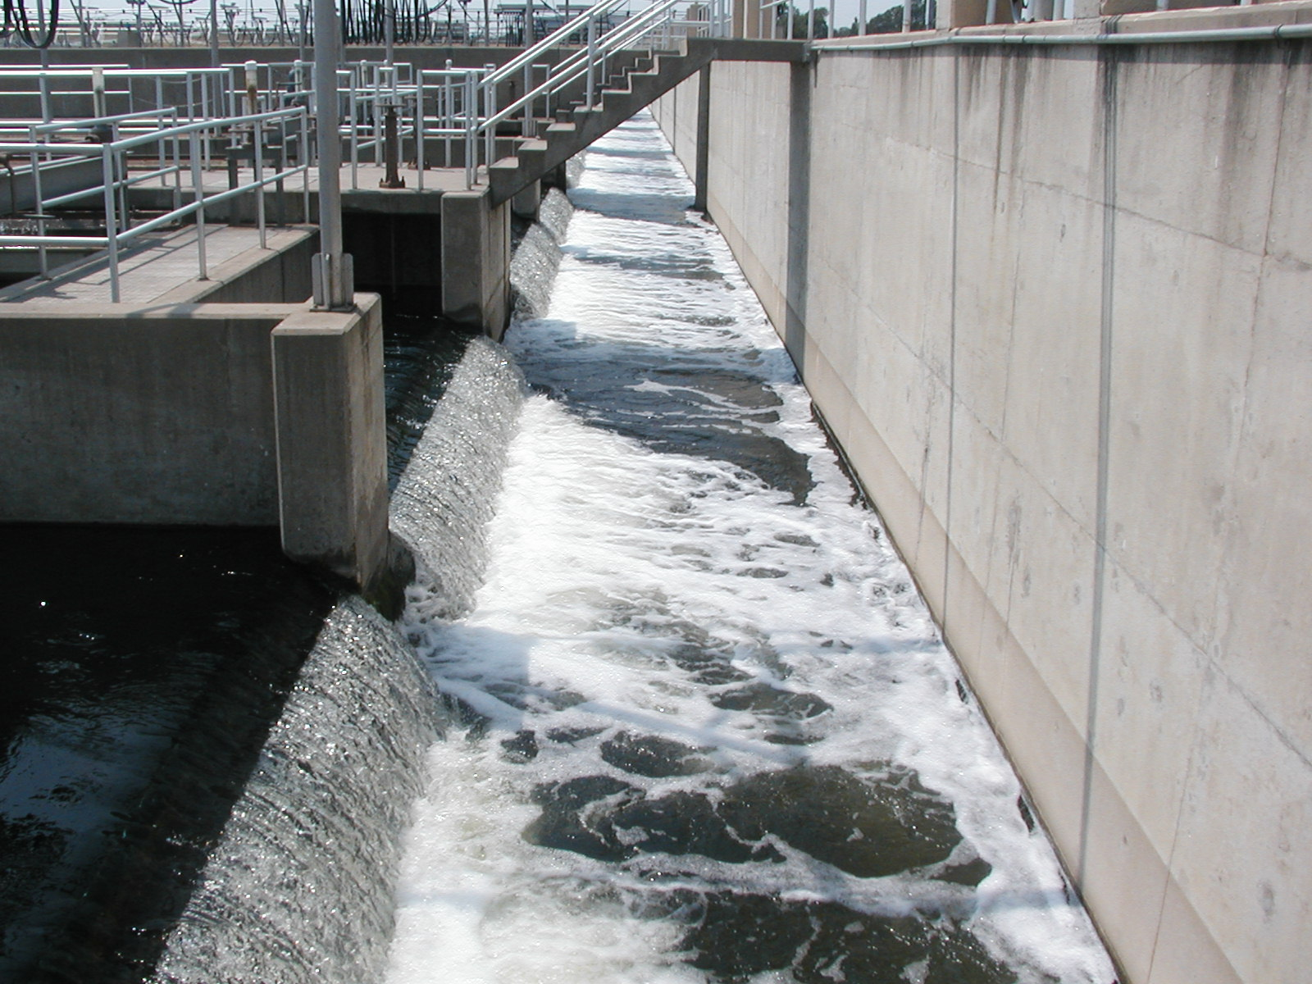
Tertiary Filter Overflow

Slide 25
Disinfection

Slide 26
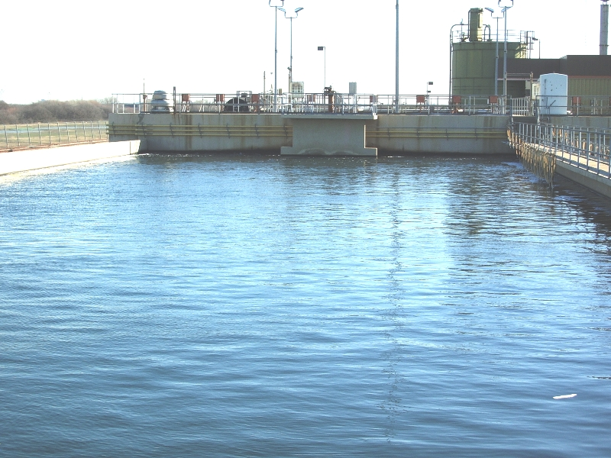
Chlorine Basins
Disinfection
Pathogen reduction
1 mg/l residual
TCEQ permit

Slide 27
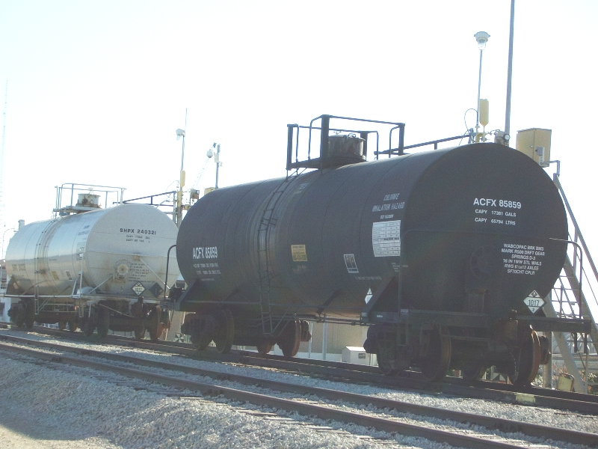
Chemical Rail Cars

Slide 28
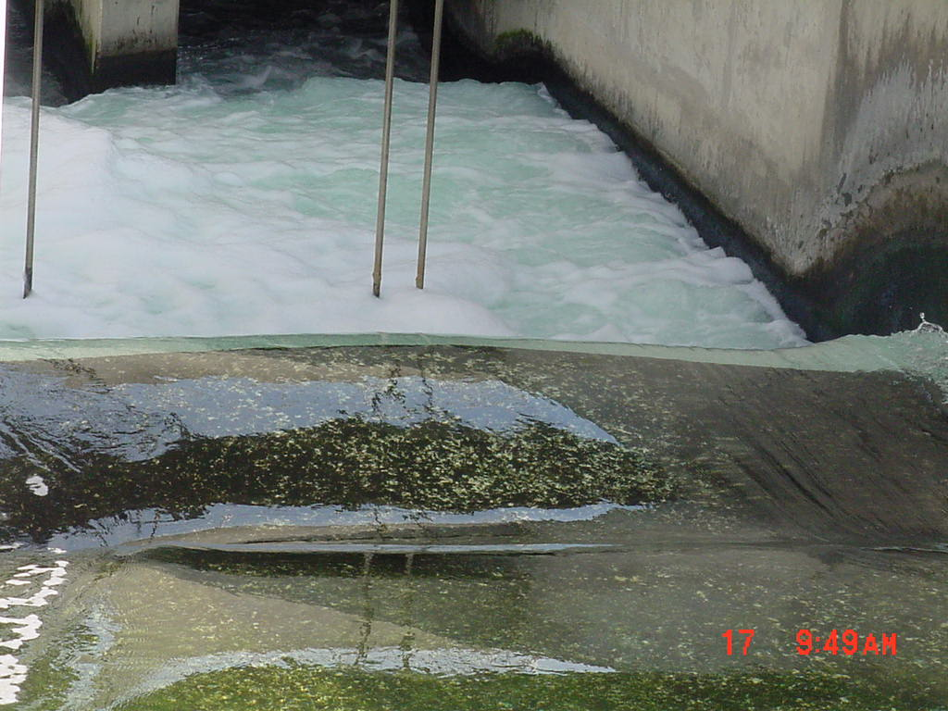
Effluent Channel

Slide 29
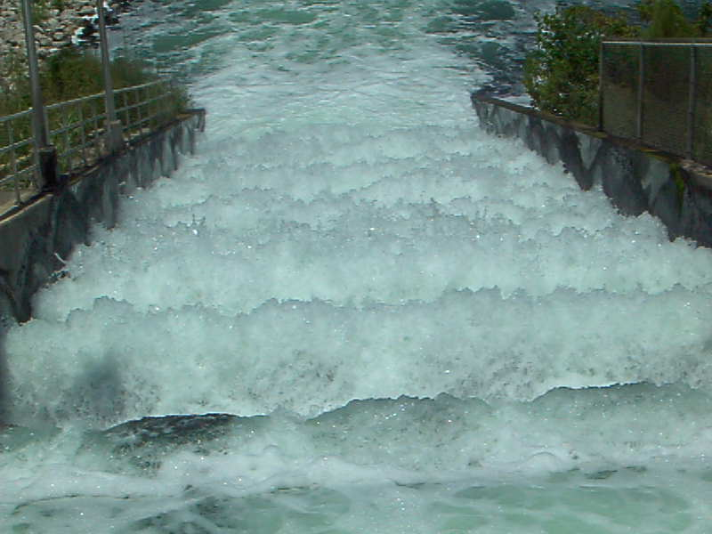
Effluent “Dragons Teeth”

Slide 30
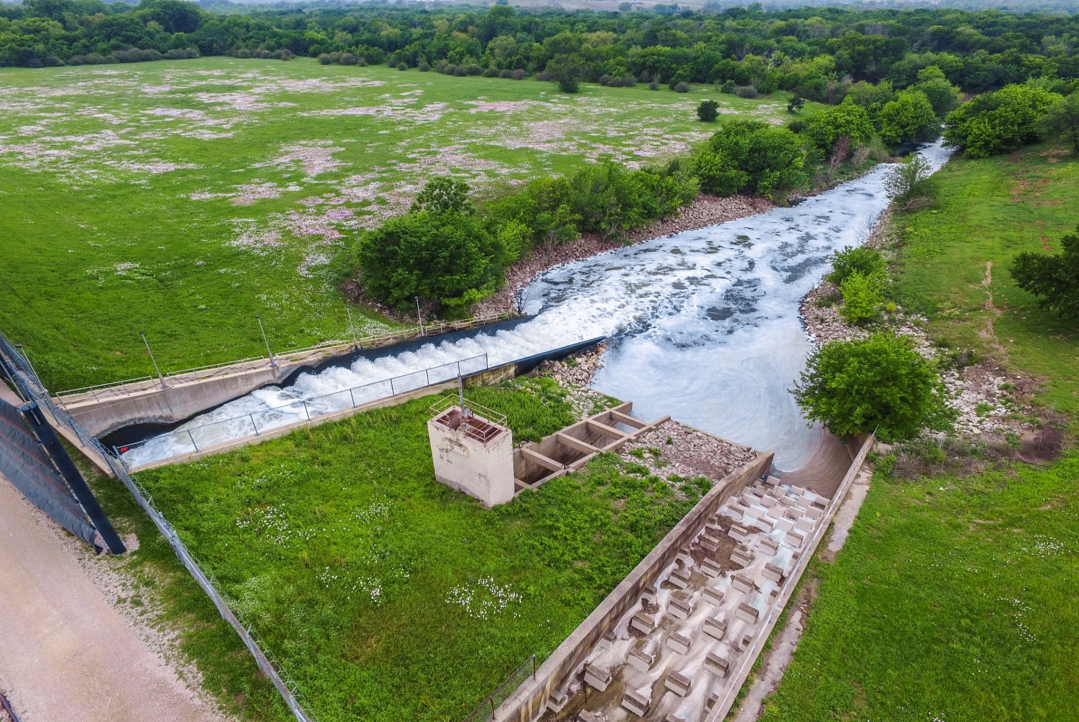
Plant Effluent Entering the Trinity River

Slide 31
Solids Improvement Project

Slide 32
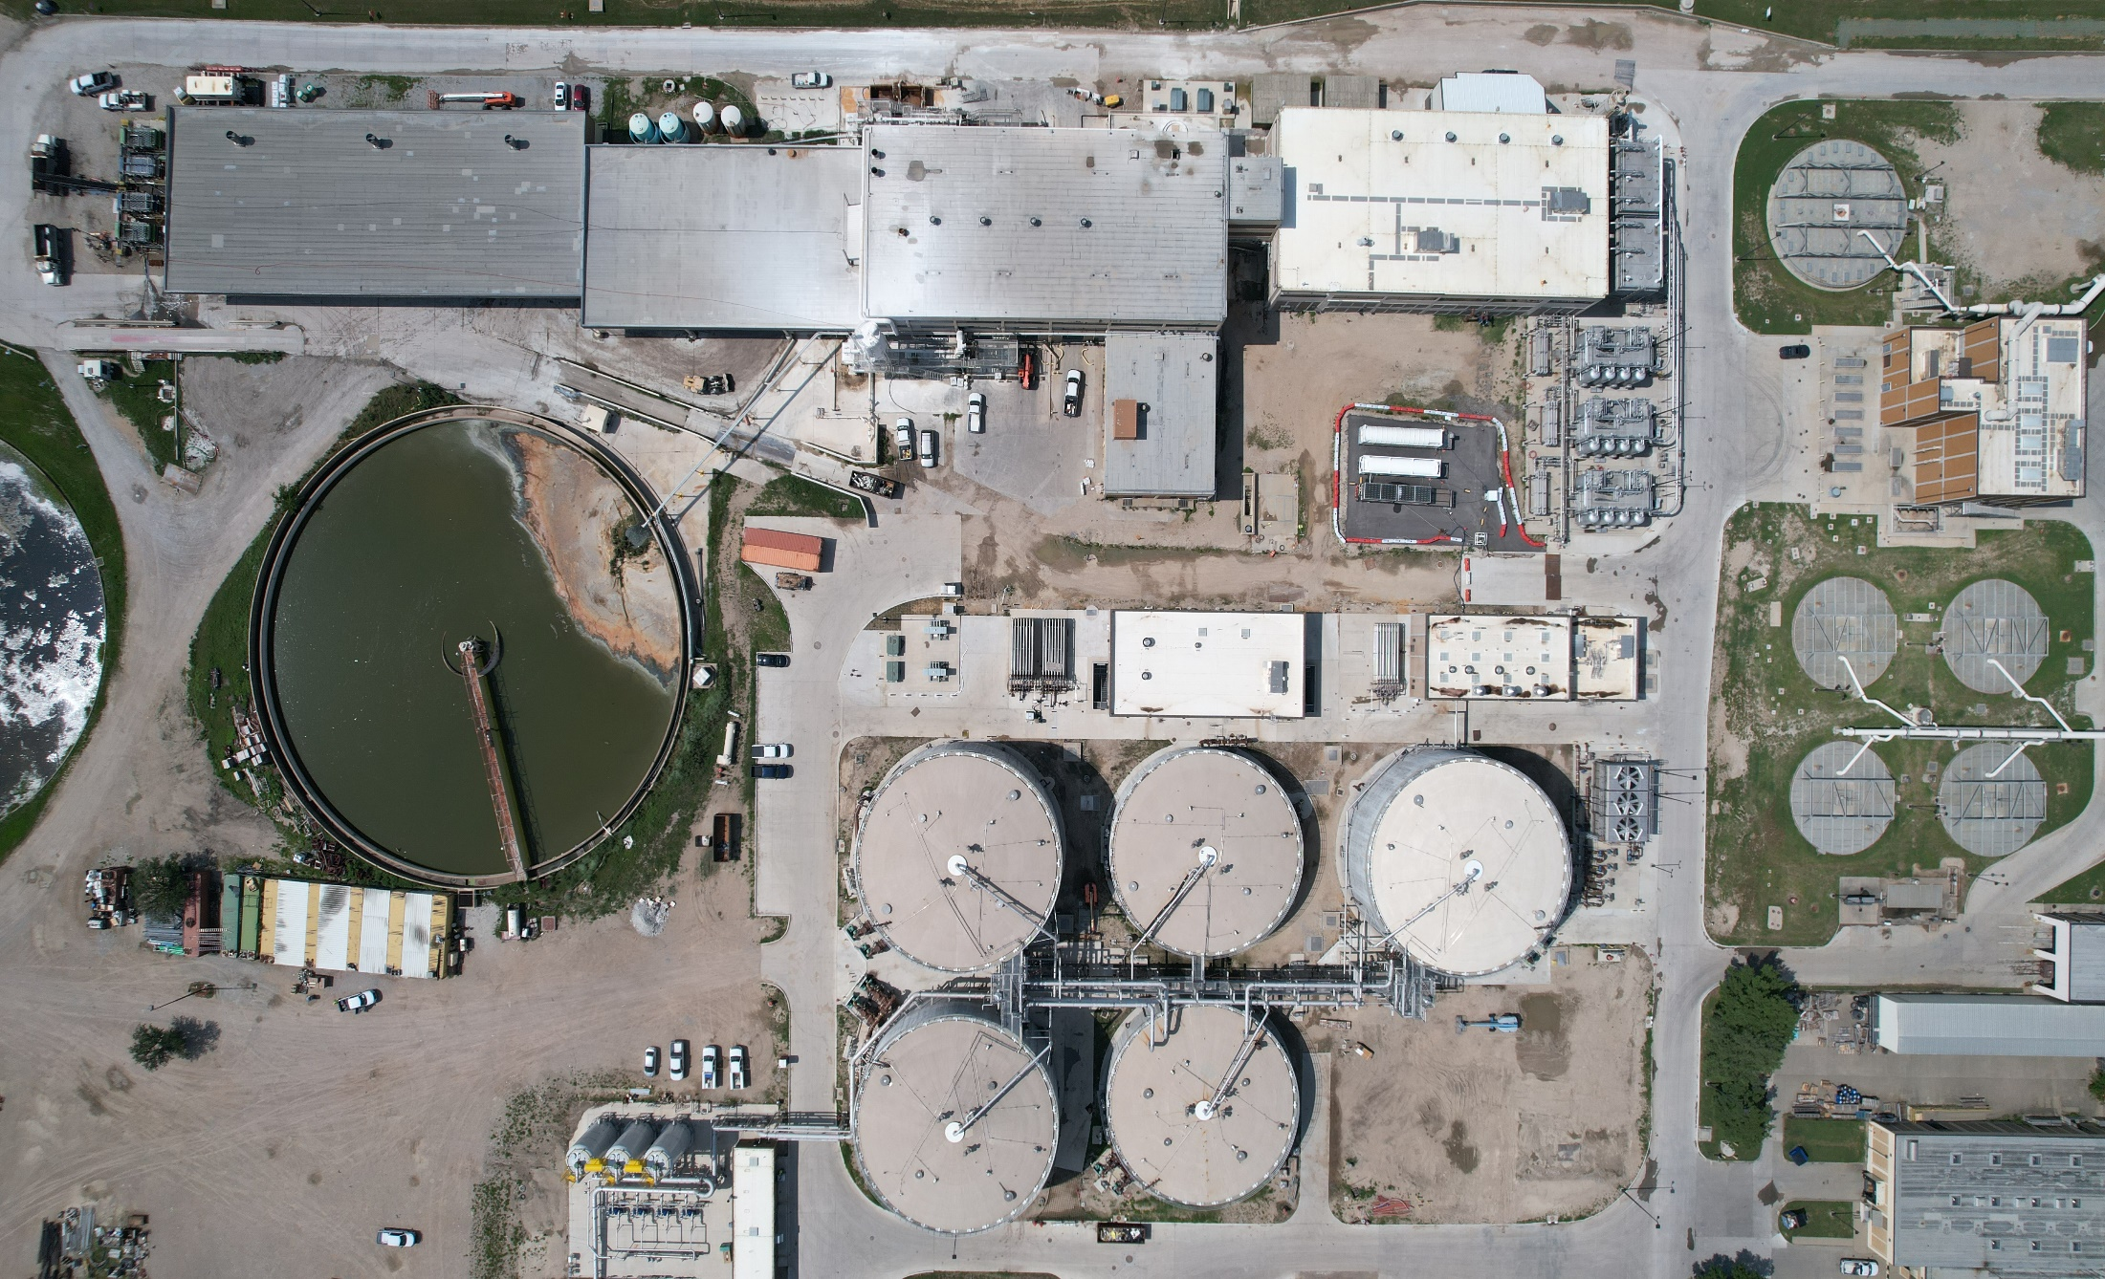
THP/Anaerobic Digestion Process

Slide 33

THP Biosolids Process
Dewatering Building
Pre-Dewatering Building
THP
Boiler Building
Anaerobic Digesters
Gas Conditioning
Notes:
Here an aerial view of the biosolids process area taken April 2023. It shows some of the major processes to produce Class A biosolids.

Slide 34
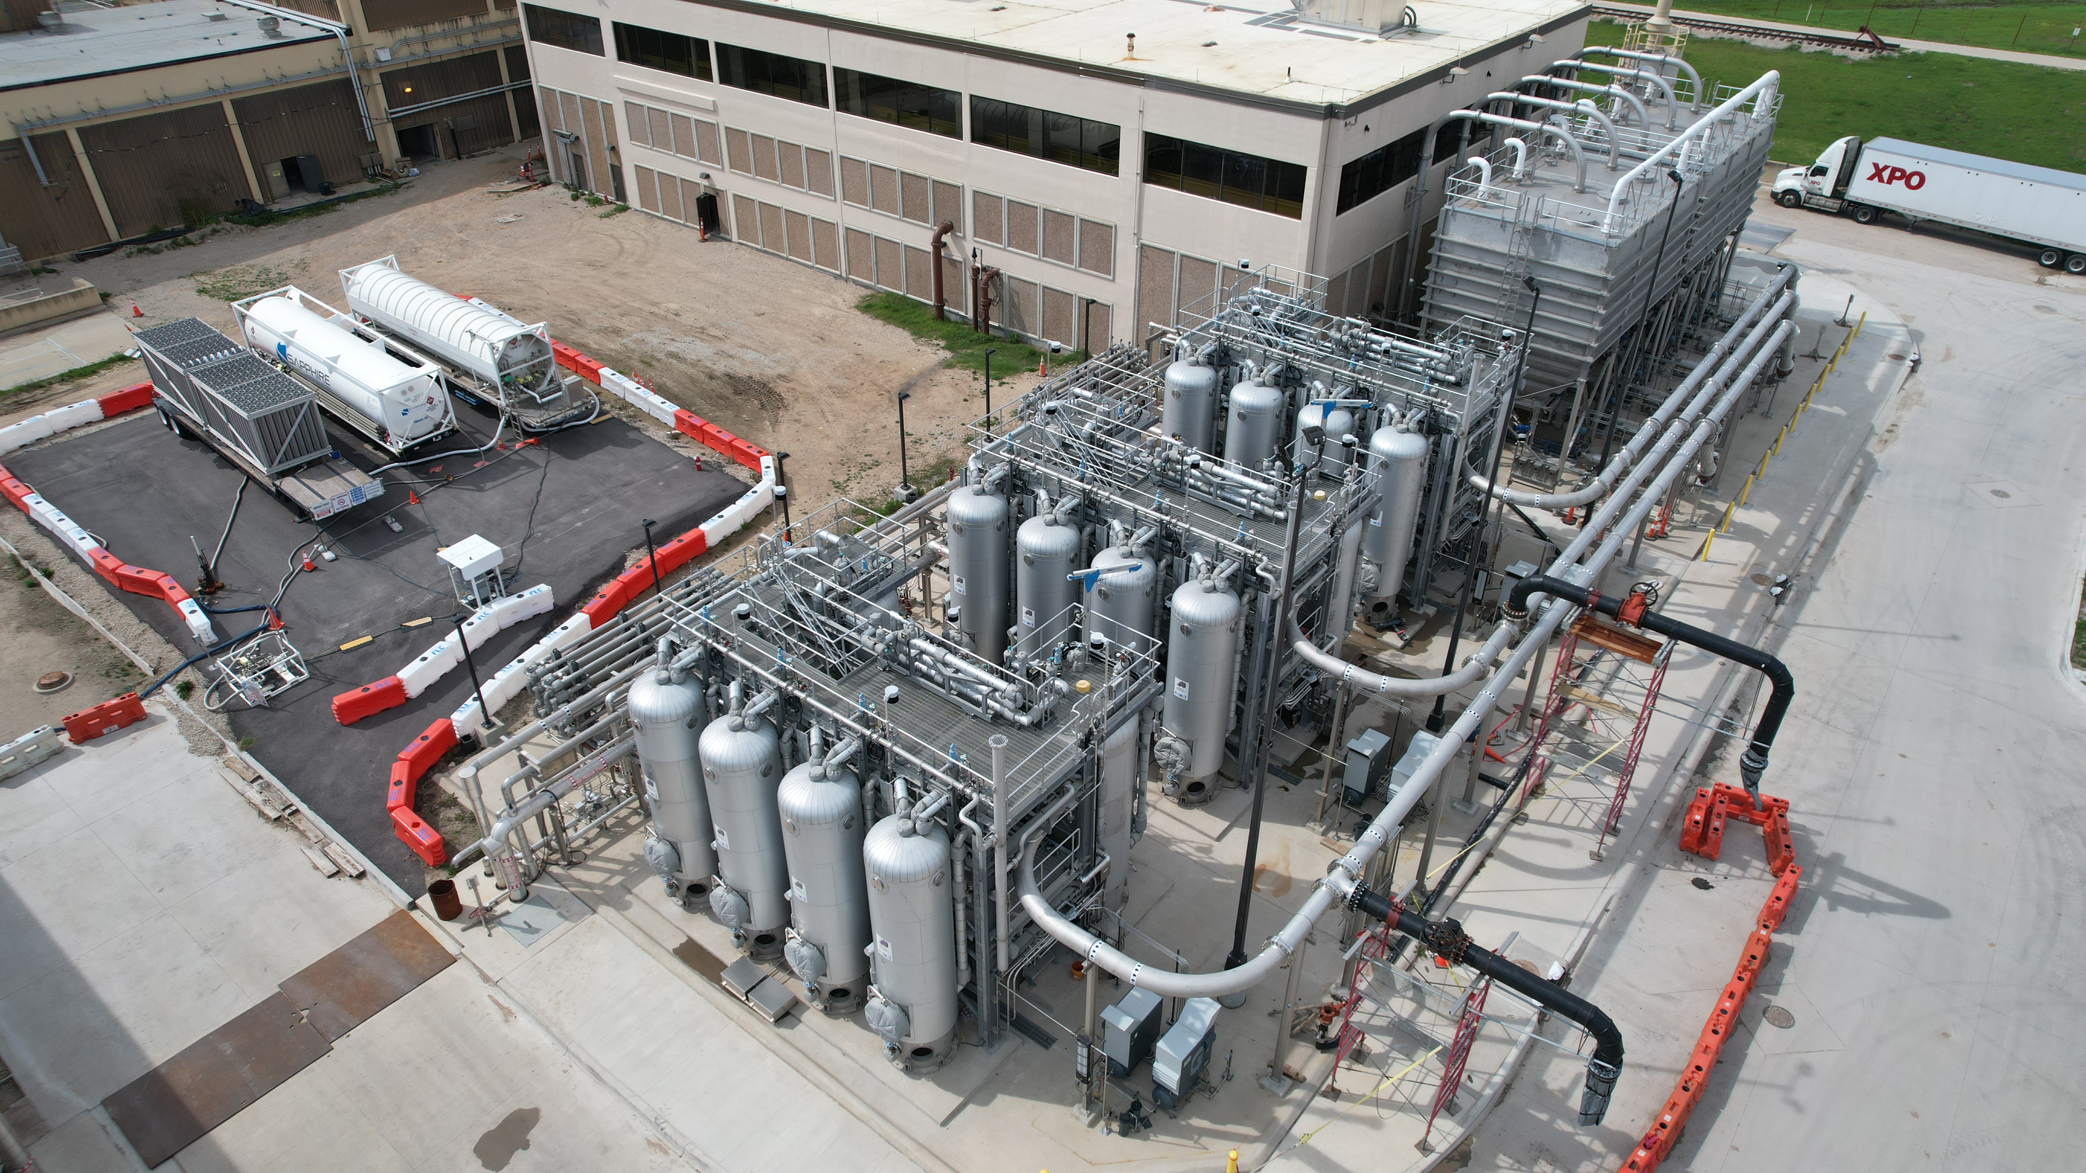
Thermal Hydrolysis Process
Reduction in the volume of biosolids
More biogas
Class “A” biosolids
Notes:
TRA has recently completion commissioning of a Thermal Hydrolysis Process at the CRWS facility.
The THP process allows biosolids to be treated to a higher quality product, with end goal of minimizing the amount of biosolids produced.
Thermal hydrolysis is a process in which biosolids are treated under pressure with the goal of improving the availability of organic solids, making them more readily biodegradeable. The process results in higher quality product, including a reduction in the amount of biosolids produced.
The THP facility at CRWS is sized for 270 DTPD (dry tons per day). It is the second largest THP facility in the US, just after DC Water at 450 DTPC. There are 4 other THP installations in the US ranging from 90 DFPD down to 25 DTPD.

Slide 35
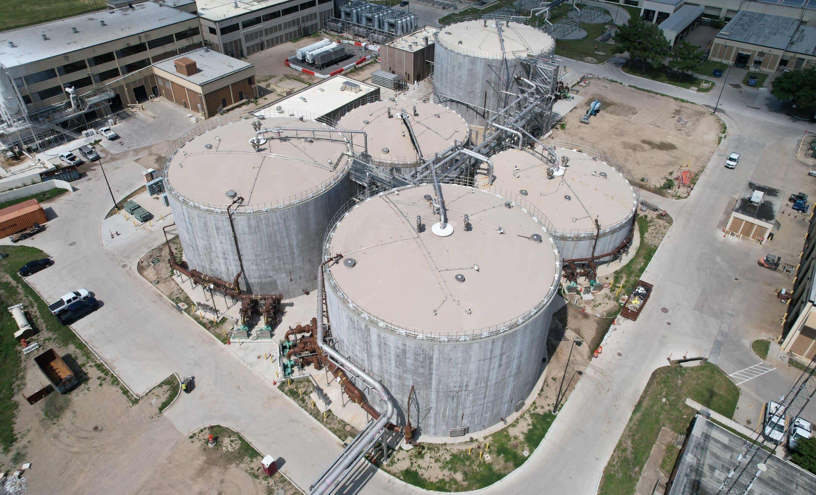
Anaerobic Digestion

Slide 36
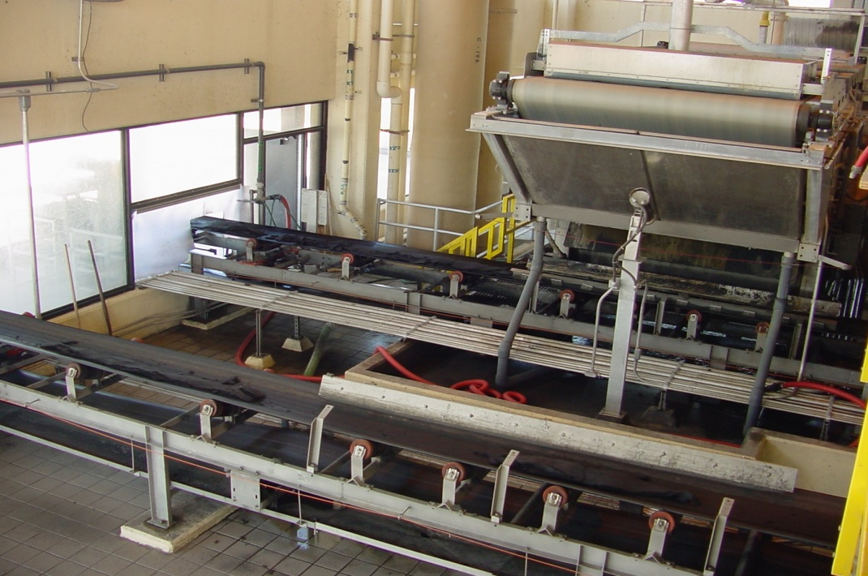
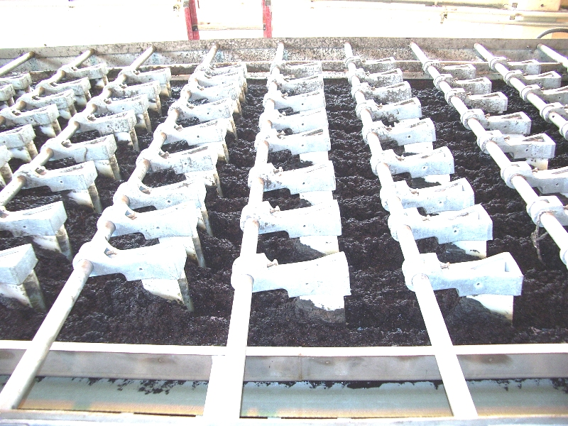
Solids Dewatering

Slide 37
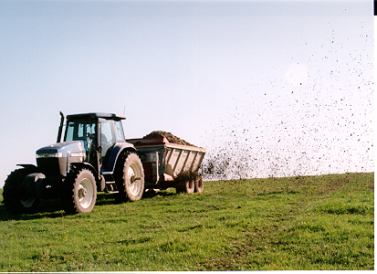
Land Application of Biosolids
FY 2022- 44 trucks/day
Currently- 23 trucks/day
Less odor
More biogas
Class “A” biosolid which meets all EPA guidelines for land application with no restrictions.
Can be used in domestic applications (farms, gardens, etc.)
Notes:
THIS IS THE LAST SLIDE IN THE "INDUSTRY CHALLENGES" PASS ON TO MARIANA – Transition to Workforce Development

Slide 38
Land Application of Biosolids

Slide 39
Questions?

